Slide 1
We are going to the National Museum of Scotland.

Slide 2
We are visiting the National Museum of Scotland on
We will be leaving school at

Slide 3
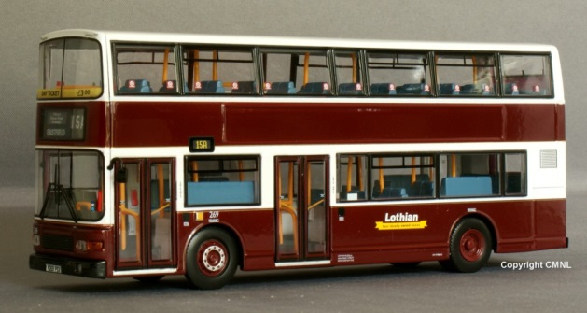
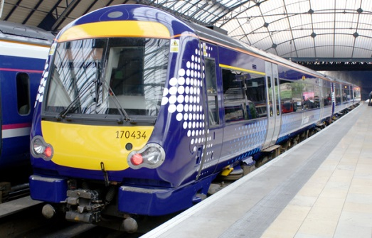
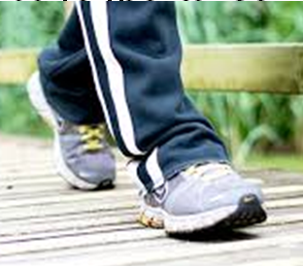
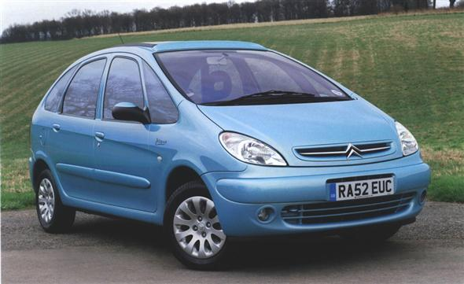
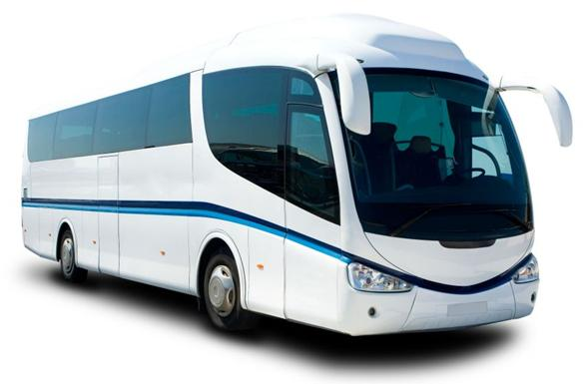
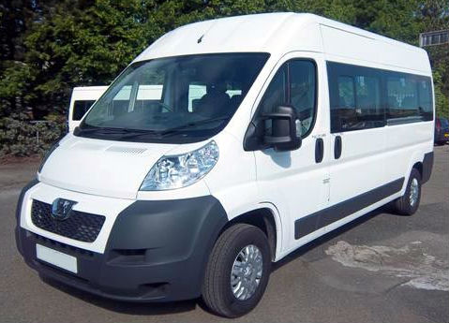
We are travelling to the museum by…
Bus
Train
Walking
Car
Coach
Minibus

Slide 4
Museum Entrance
We will go into the museum through this entrance.
We can go through the revolving doors or push a button to go in.

Slide 5
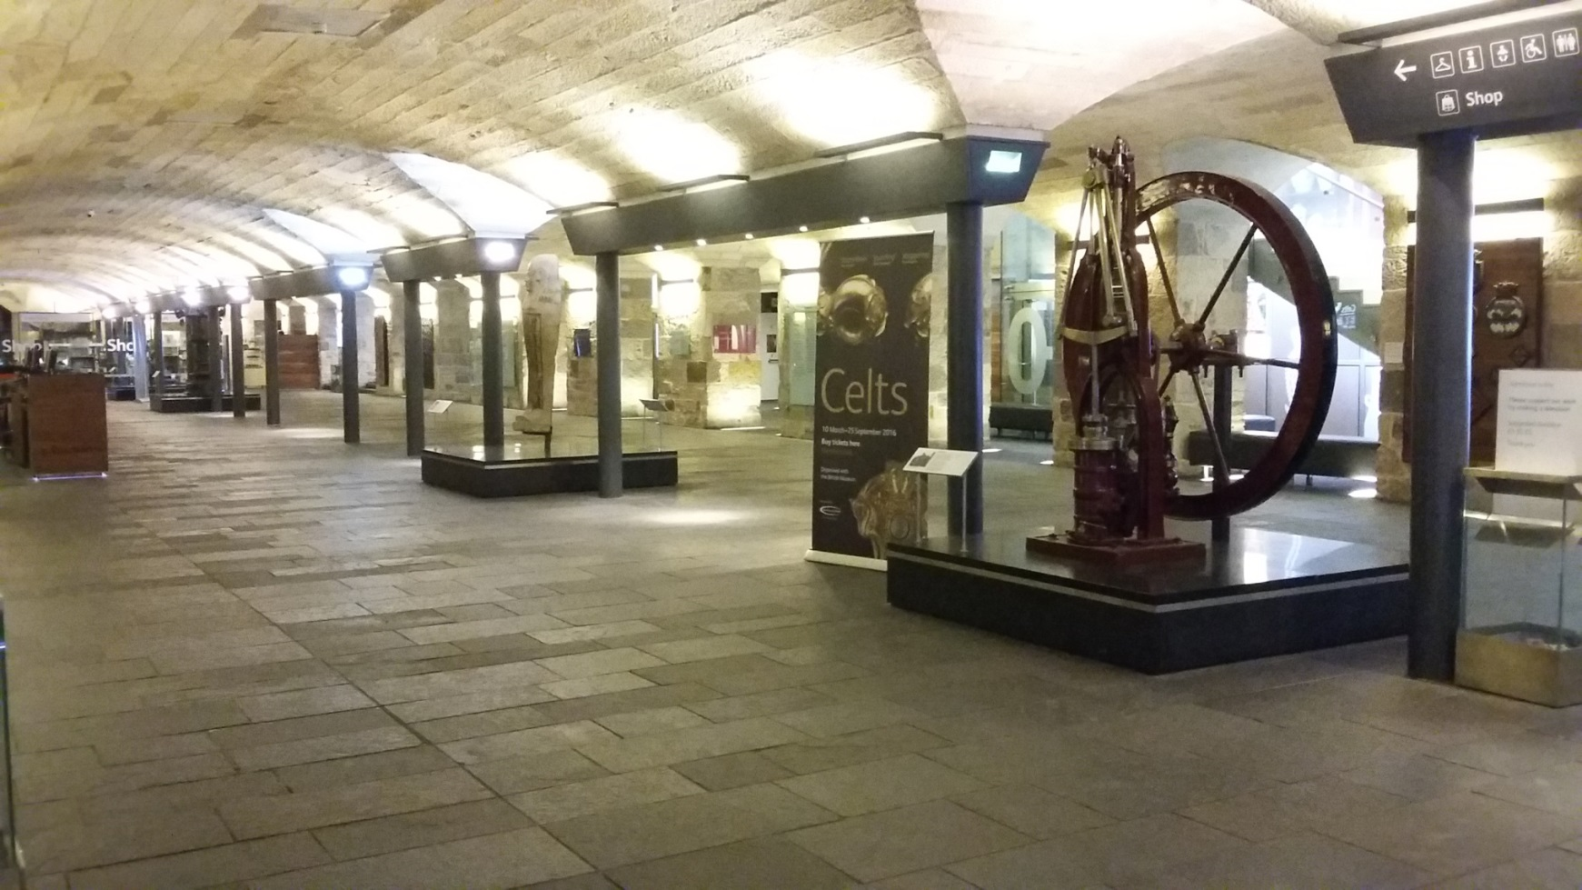
This is the museum Entrance Hall
It might be busy.

Slide 6
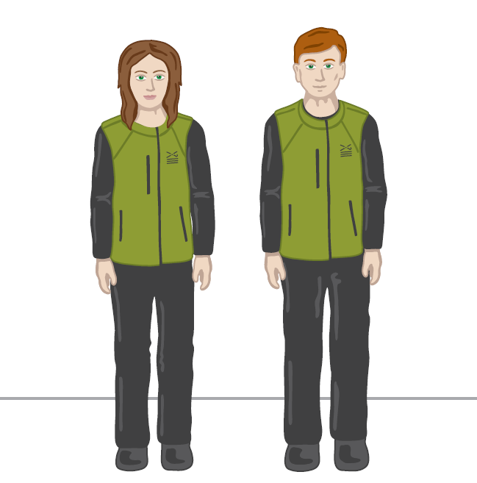
We might meet an Enabler. They wear uniforms that look like this and might be wearing face masks.

Slide 7
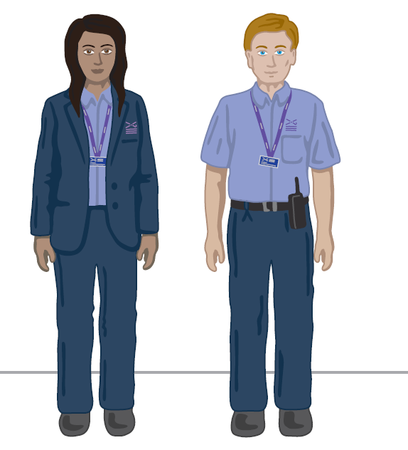
We might meet a Visitor Experience Assistant. They wear uniforms that look like this and might be wearing face masks.

Slide 8
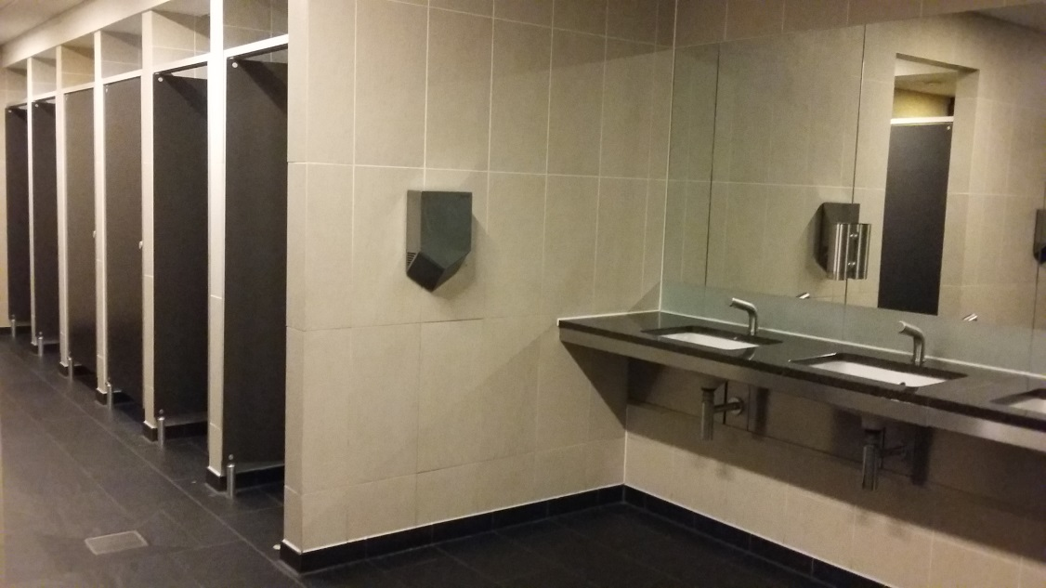
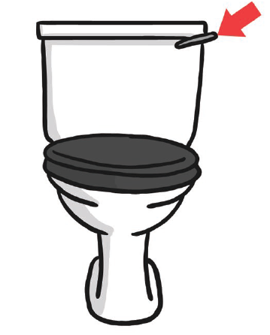
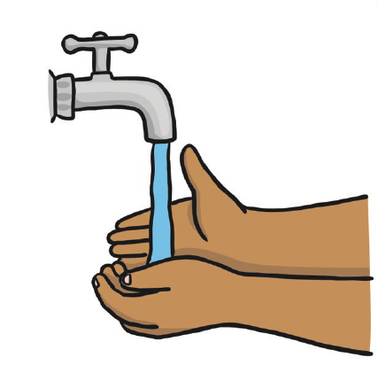
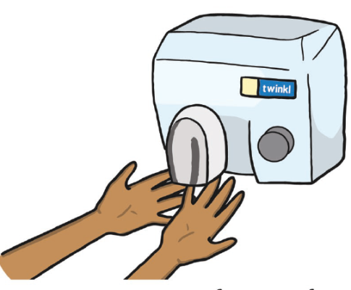
These are the toilets in the Entrance Hall.
The hand dryers are very loud.

Slide 9
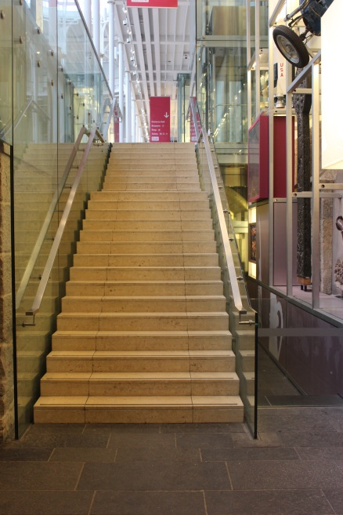
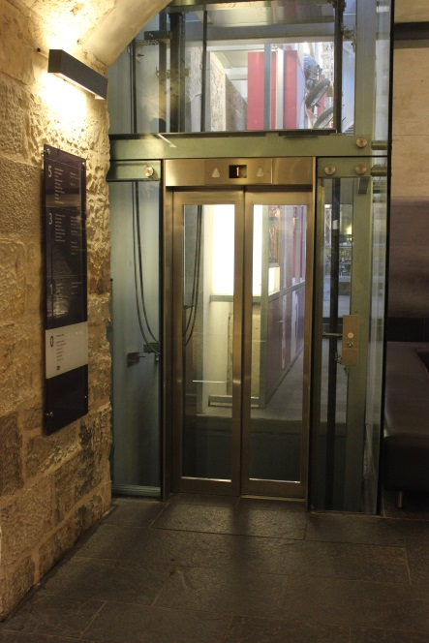
From the Entrance Hall we will go up the stairs to get to the Grand Gallery. We can also take the lift.
Stairs
Lift

Slide 10
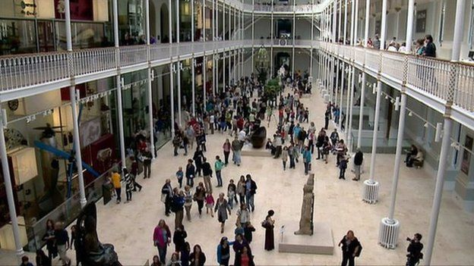
We will move around the museum in a group. It might be busy and noisy with people talking.

Slide 11
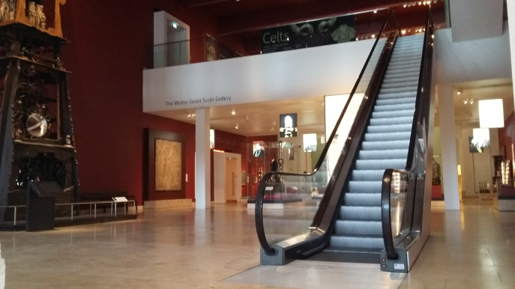
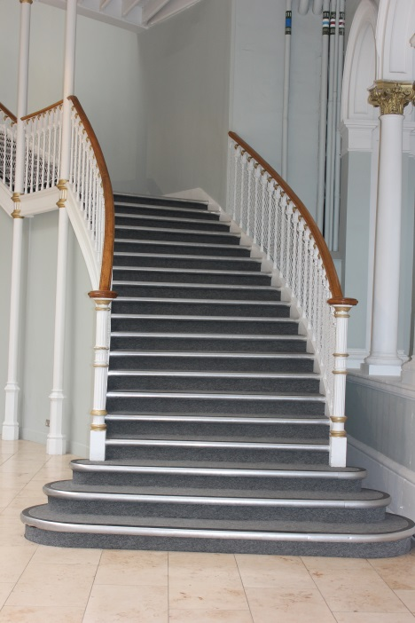
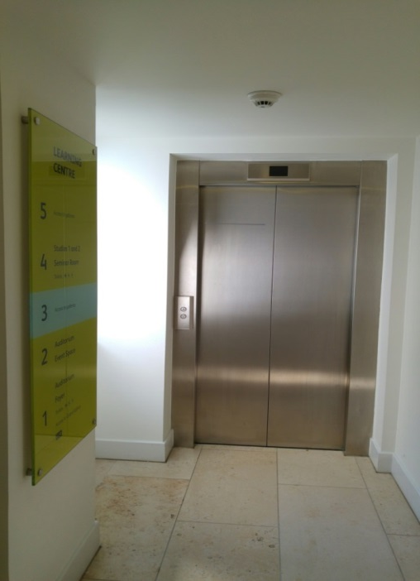
We can explore the museum.
We might need to use stairs, a lift or an escalator to go upstairs.
Escalator
Lift
Stairs

Slide 12
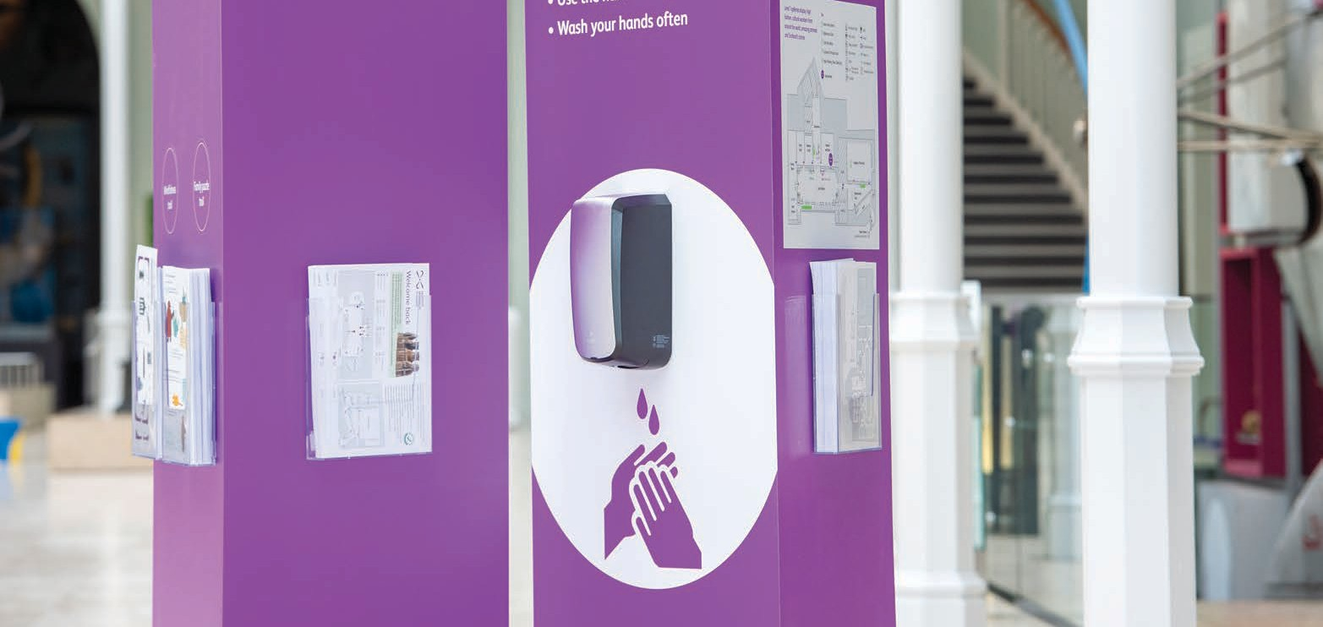
There are hand sanitising stations if I want to clean my hands.
I will find these stations throughout the museum.

Slide 13
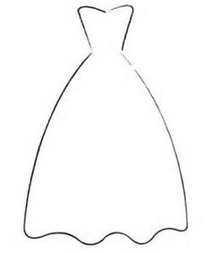
The museum has lots of different things in it. It has objects about…
Space
Scotland
Animals
Fashion
Art and design
Science and technology
And things from all across the world

Slide 14
While we are at the museum we will…

Slide 15
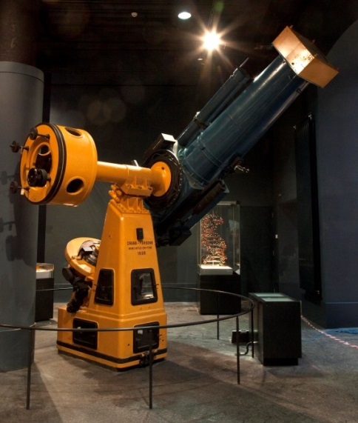
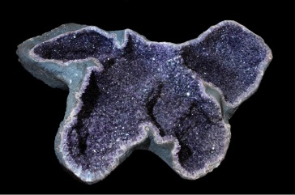
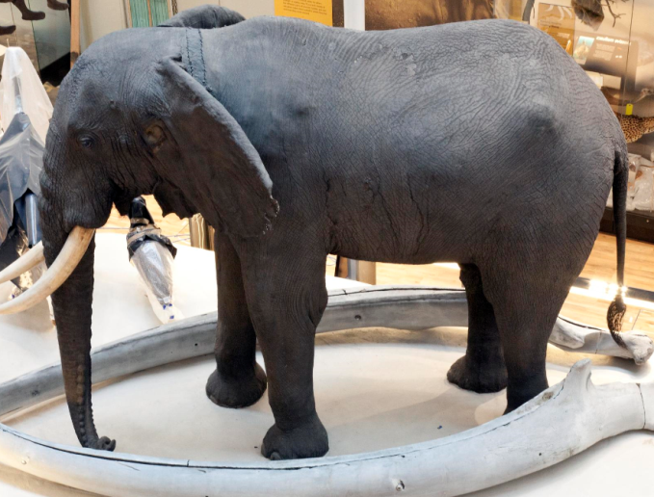
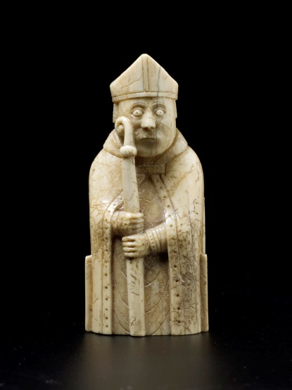
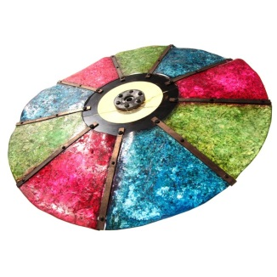
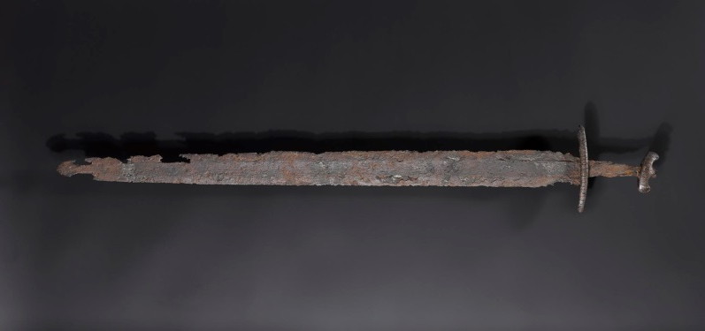
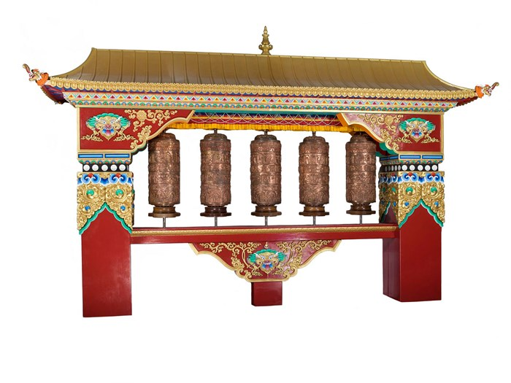
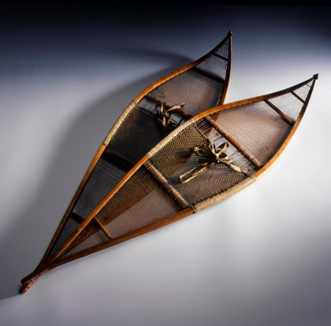
See lots of interesting things.
Some things we will have seen before and some might be new.

Slide 16
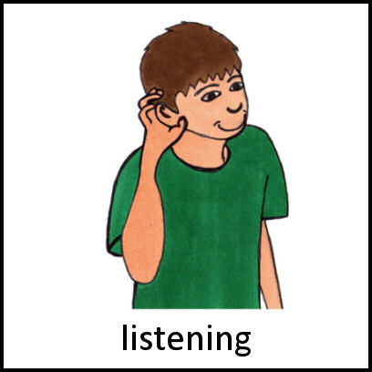
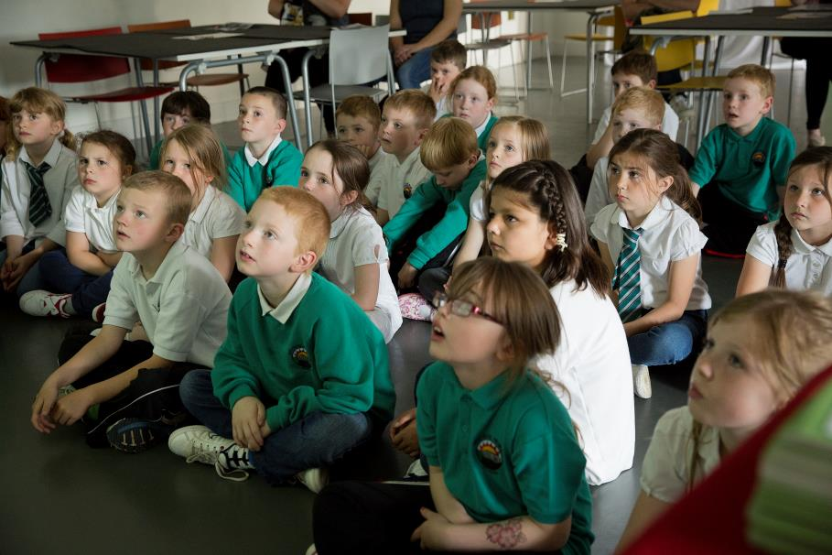
Listen to our adults

Slide 17
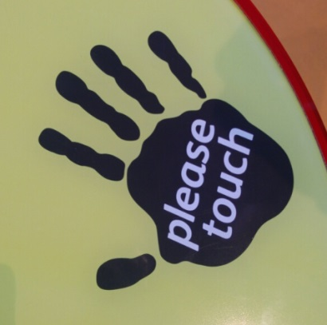
We might get to touch some objects
If we can see the ‘please touch’ sign on an object then we can touch it! If not, don’t touch the object.
There are hand sanitiser stations to use before and after I touch objects.

Slide 18
Today we are going to learn about…

Slide 19
We will look at…
Add in what you are planning on looking at e.g.
Animals
Space
Vikings etc.
If you want to add in pictures of some of the museums’ objects you can search the collections here: http://www.nms.ac.uk/explore/search-our-collections/
This could be a fun pre-visit planning activity.

Slide 20
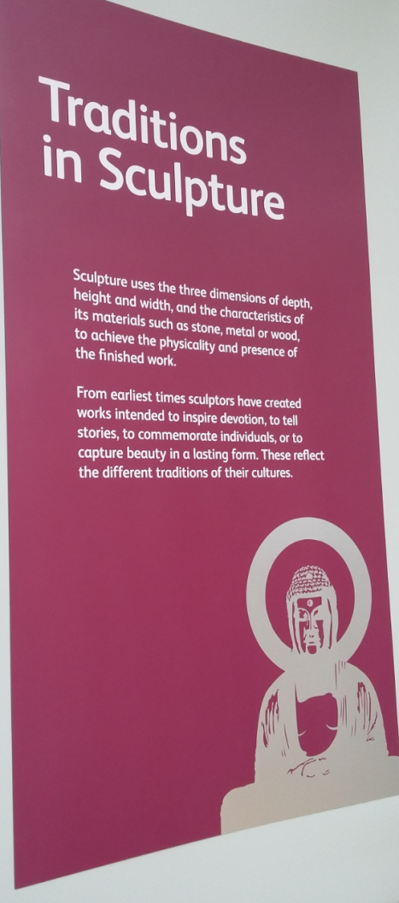
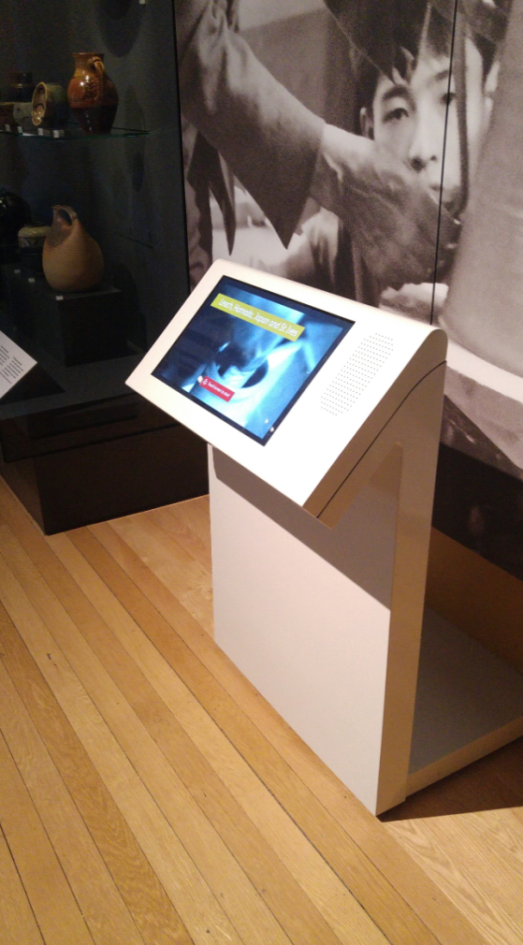
We can find out more about them.
Panels on the wall and labels in the cases will tell us about the things we see.
There might be touchscreen computers where we can find out more.

Slide 21
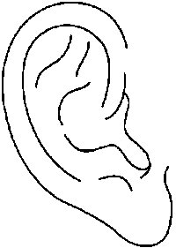
We might hear…
Other people talking, shouting and laughing
Music from the Millennium clock or from musical instruments
Beeps, whirring and clanking from some of the machines

Slide 22
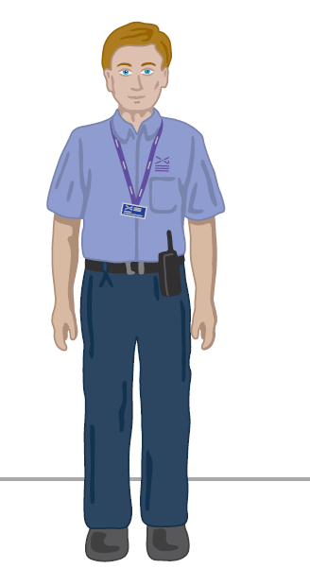
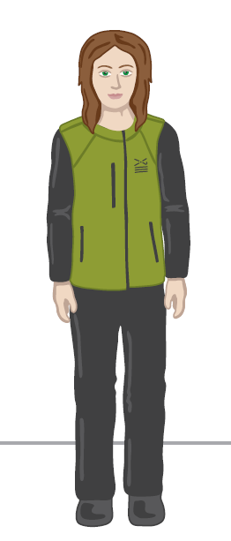
If we need a break or want to ask a question about the museum we can talk to someone who works at the museum.
They wear uniforms that look like this:
Visitor Experience Assistant
Learning Enabler

Slide 23
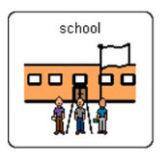
We will leave the museum at
And go back to school.

