Slide 1
Rising Heat, Raising Hope
Climate Change for Children
Community Quilt
Your guide to contributing to the nationwide art project

Slide 2
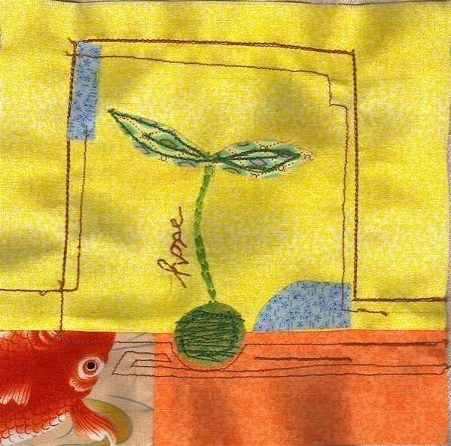
The Quilt Project – What is it?
National Museums Scotland invites children, families, and communities to join a project focusing on Climate Change for children.
You are invited to make panels for a quilt, which will be joined together with other people's by the end of the school year.
Once completed, the Rising Heat, Raising Hope: Our Quilt Project will be exhibited in the National Museum of Scotland's Learning Centre and online.
The quilt will give children a voice, to share their views on climate change, and a message of hope.
Hope.
Quilt Block responding to Japan’s 2005 Miyagi earthquake and tsunami
© Karen 2005

Slide 3
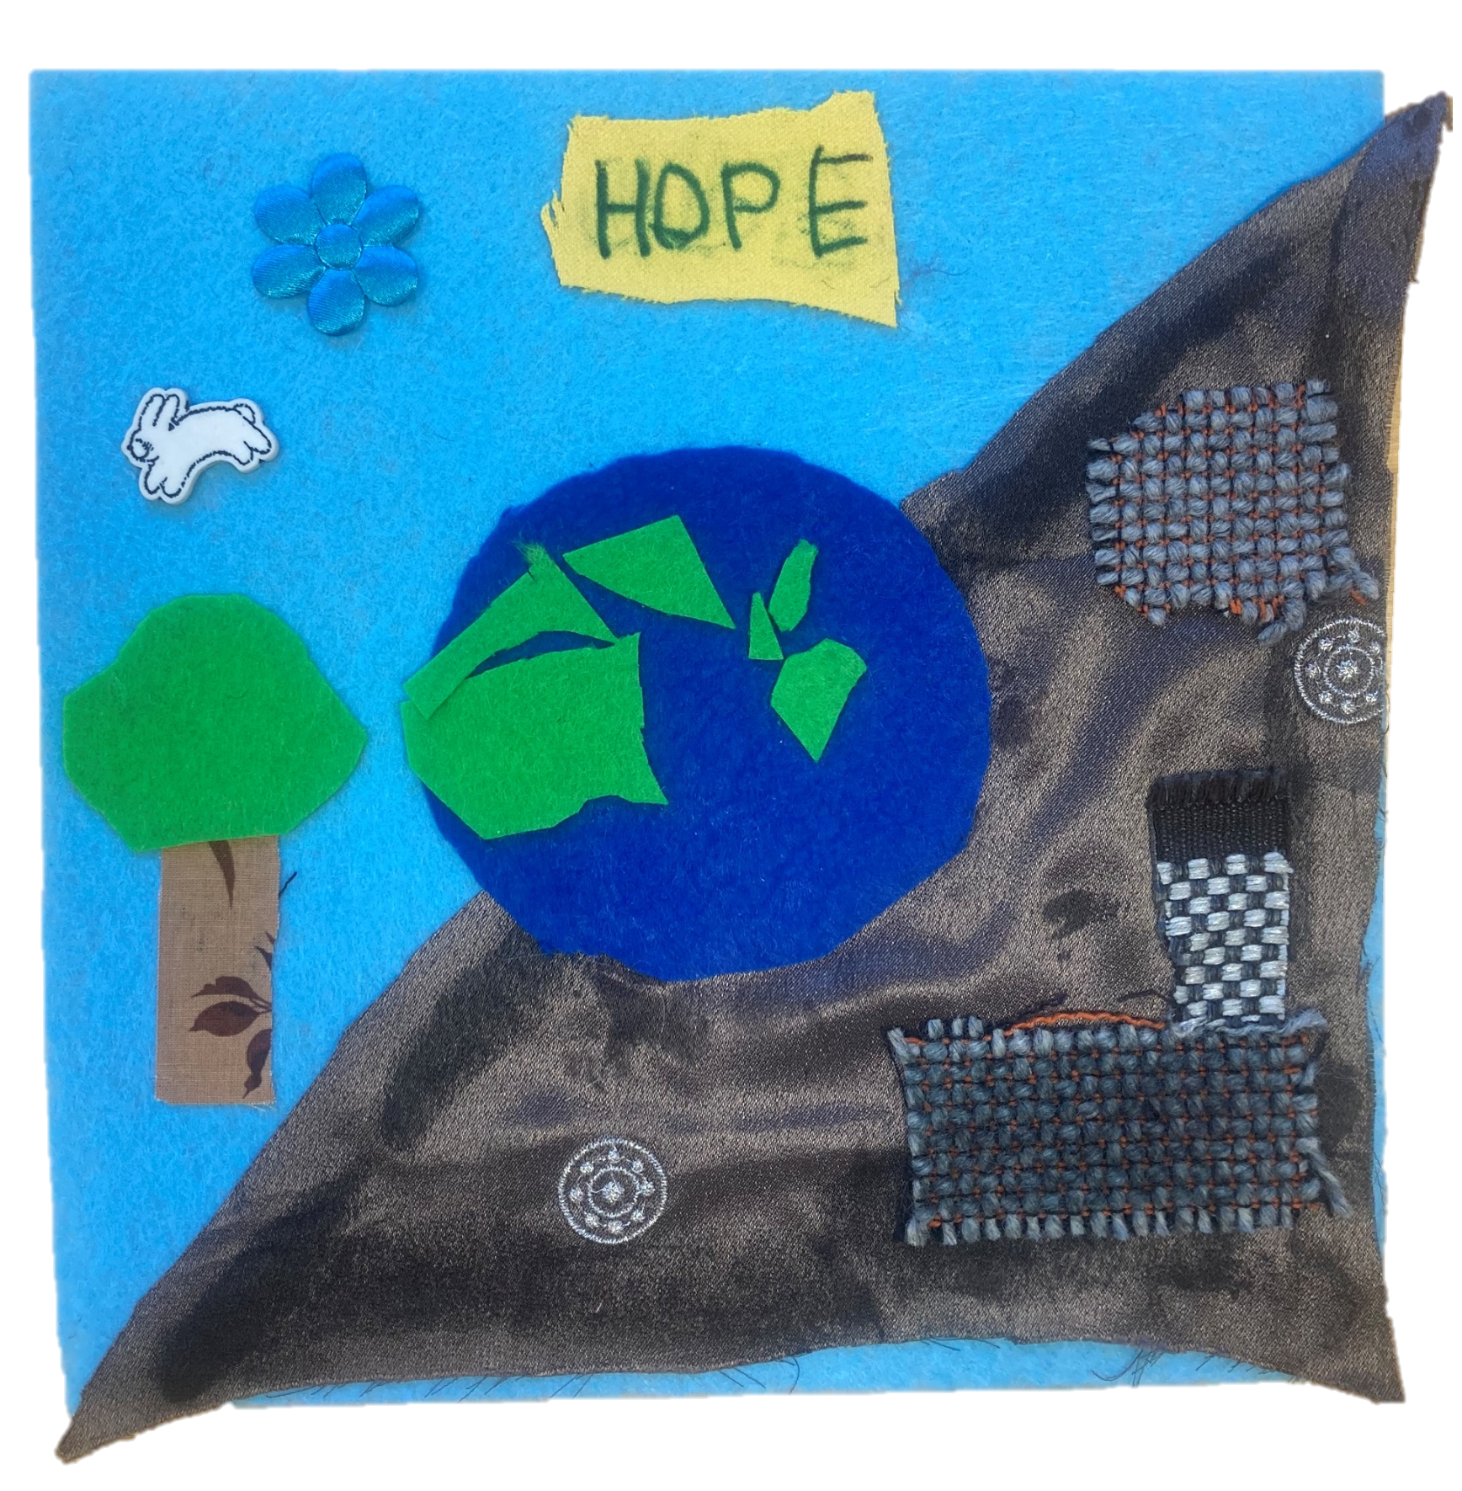
Our Goals – What are they?
Learn more about climate change and the impacts on children.
Engage and unite communities in explorations of climate change through art and science.
Empower children to creatively express their concerns regarding climate change.
Explore the National Museums Scotland collections.
Promote a message of hope.
Image © Laura Johnson
Image © https://climatesolutionsquilt.wordpress.com/photo-gallery/

Slide 4
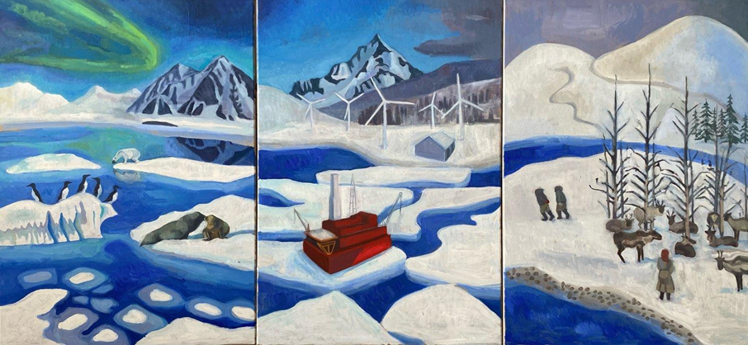
Our team – Who is helping us?
Grant funded painting by Natural Environment Research Council (NERC) on climate impacts on the Arctic. © Laura Johnson
Workshop Artist: Laura Johnson
Artist & Teacher
MSc in Environment & Development
MFA in Painting & Drawing
Workshop Scientist: Dr Sian Henley
Scientist, Explorer & Teacher
Reader in Marine Science
University of Edinburgh

Slide 5
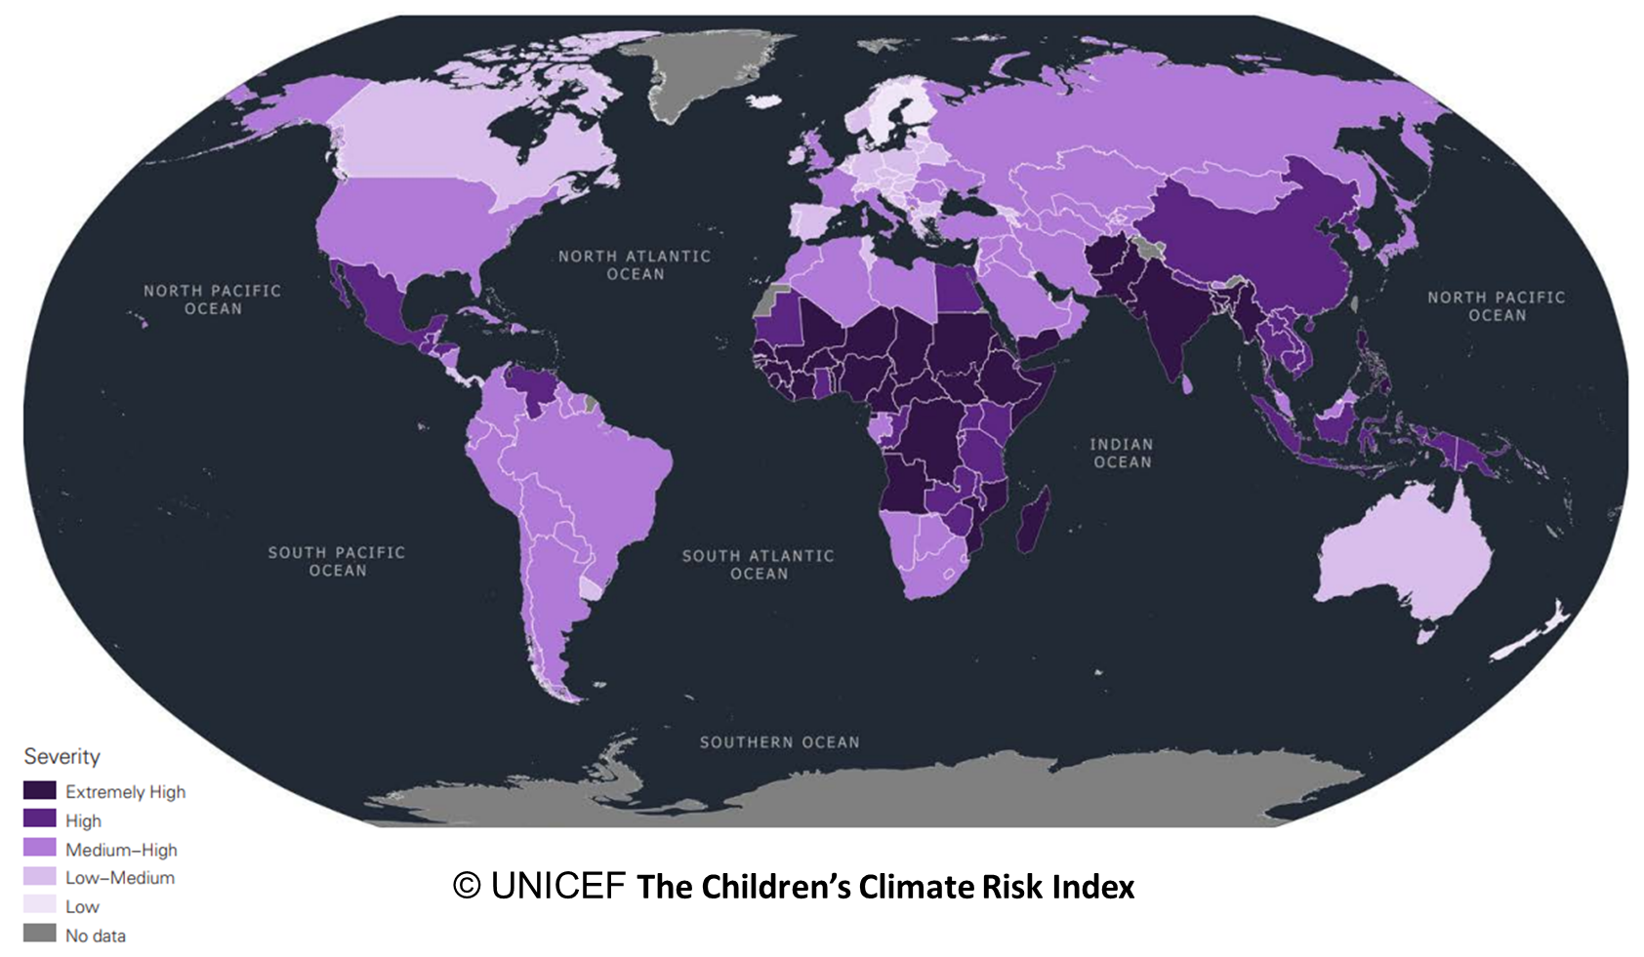
Climate Change – What is it?
© UNICEF
Rising Heat, Raising Hope
Climate Change for Kids
Our Quilt
A guide to contributing to the nationwide art project
Learn about the Children’s Climate Risk Index with Dr. Sian Henley
Watch the video
Digital schools sessions | National Museums Scotland (nms.ac.uk)
nms.ac.uk/SchoolsClimateChange
Notes:
.

Slide 6
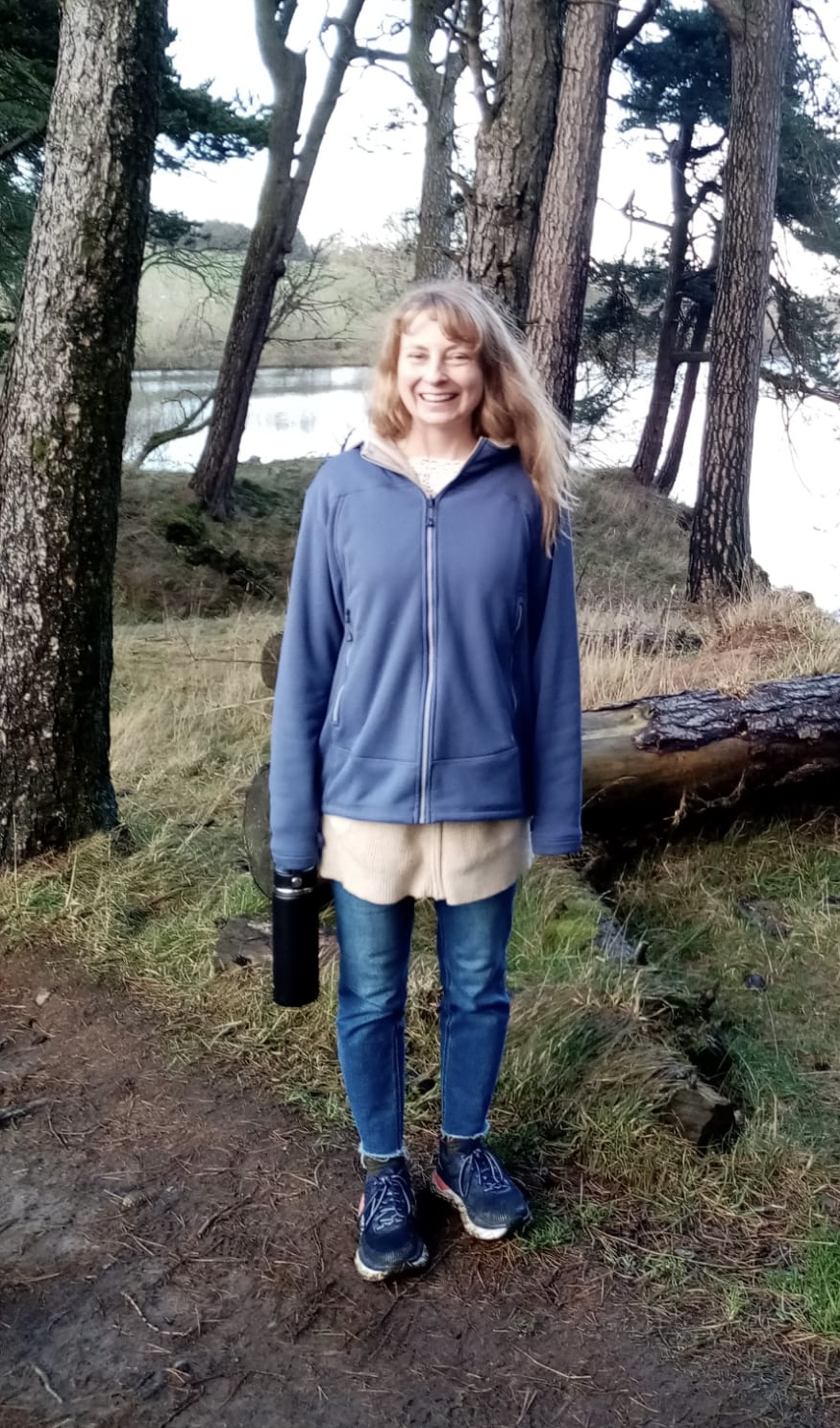
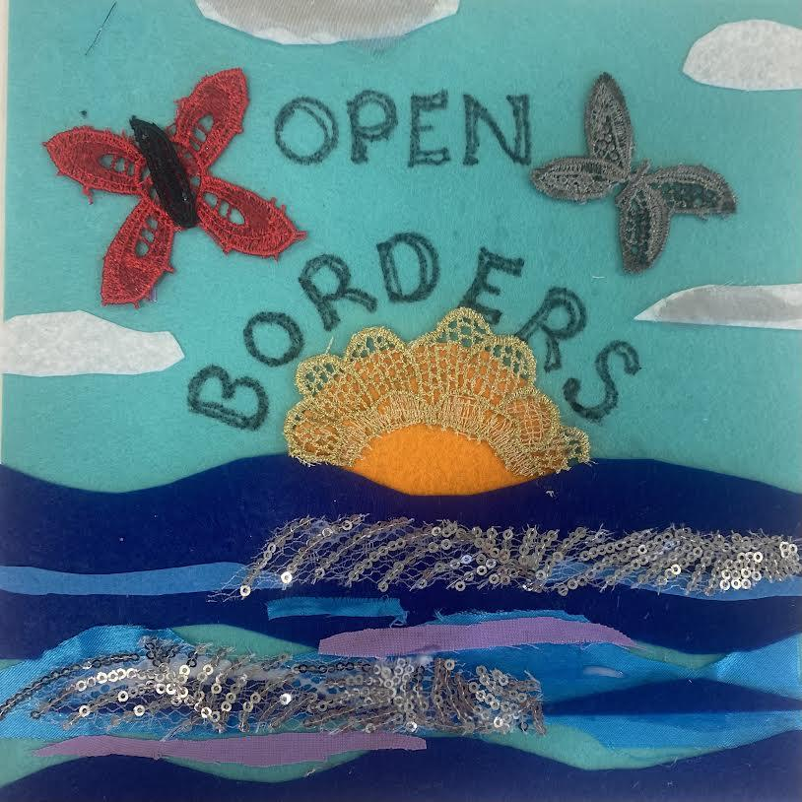
Meet the artist!
Hi I’m Laura!
I am an artist, licensed art teacher, environmental activist and social scientist.
I am passionate about working with children to raise their voices through the visual arts. I feel the arts are an effective vehicle for children of all ages to share their concerns globally on subjects that affect them. For example, climate change impacts almost every single child on earth, and all humans should pay attention to children's thoughts on that. I believe our children's climate quilt can help highlight participants' views across cultures and borders through its quiet visual power. I have a Master in Fine Arts (MFA) in Painting and Drawing. I also have a Masters of Science (MSc) in Environment and Development from the University of Edinburgh.
In my free time, in addition to painting and environmental activism, I enjoy racing sailboats, running, hiking, yoga and meditation. My art website (which includes my students’ work) is
www.aplaceformyart.com
Quilt square by Laura Johnson
Image © Laura Johnson
Image © Laura Johnson

Slide 7
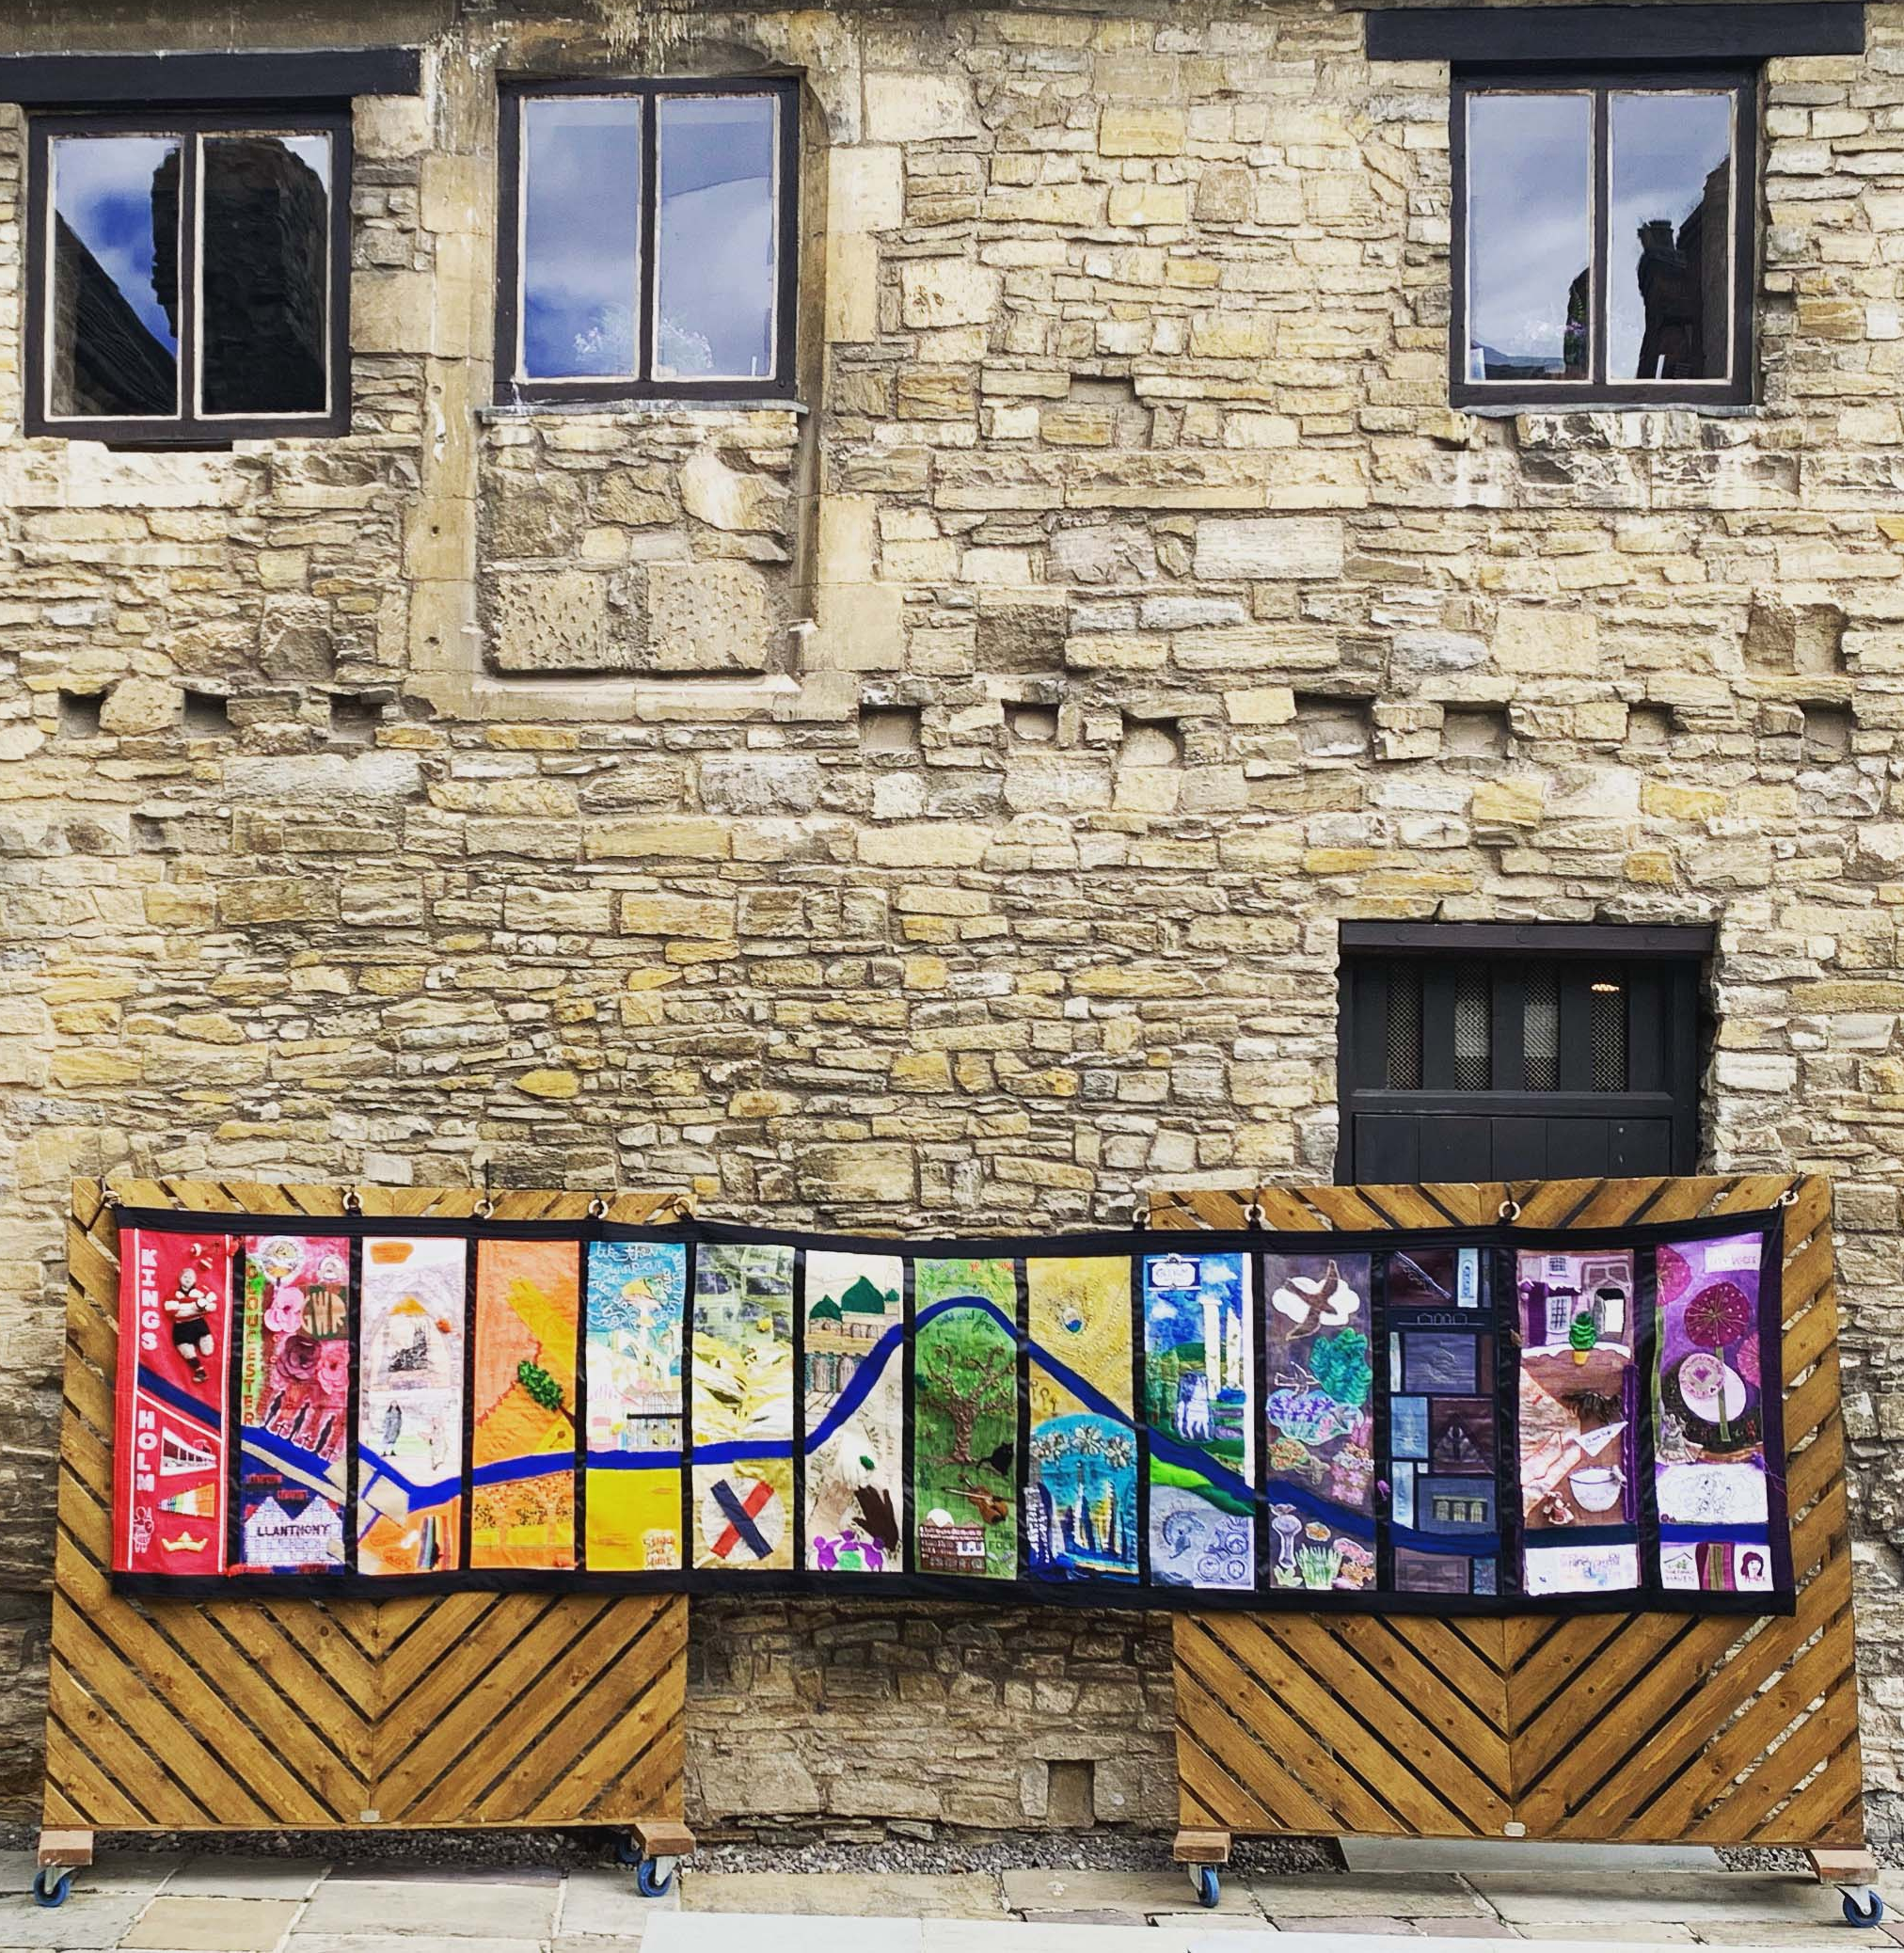
Introduction to quilting
Quilting has often been used to bring people together, share ideas, and build community.
Discuss the meaning of a quilt with your class
Has anyone in your class seen a quilt before?
Explore the special reasons quilts are made
What do you think the quilt on this slide is trying to share?
For three months, 14 craft women from different backgrounds, met every week at Gloucester Archives and shared stitches, life stories and laughter while creating this wonderful artwork. Inspired by the Bayeux Tapestry, they have created their own interpretation of the history and heritage of Gloucester, with their own stories and inspiration.
© https://voicesgloucester.org.uk/events/stitch-in-time/

Slide 8
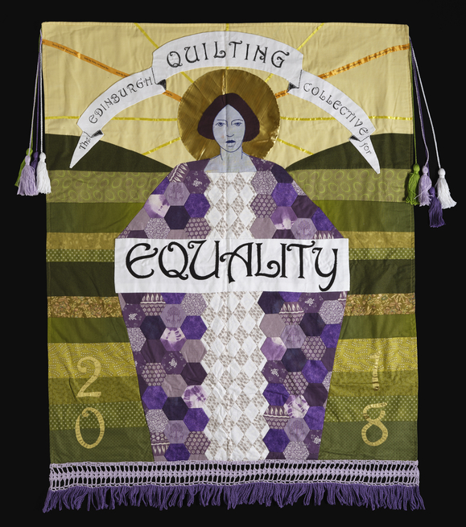
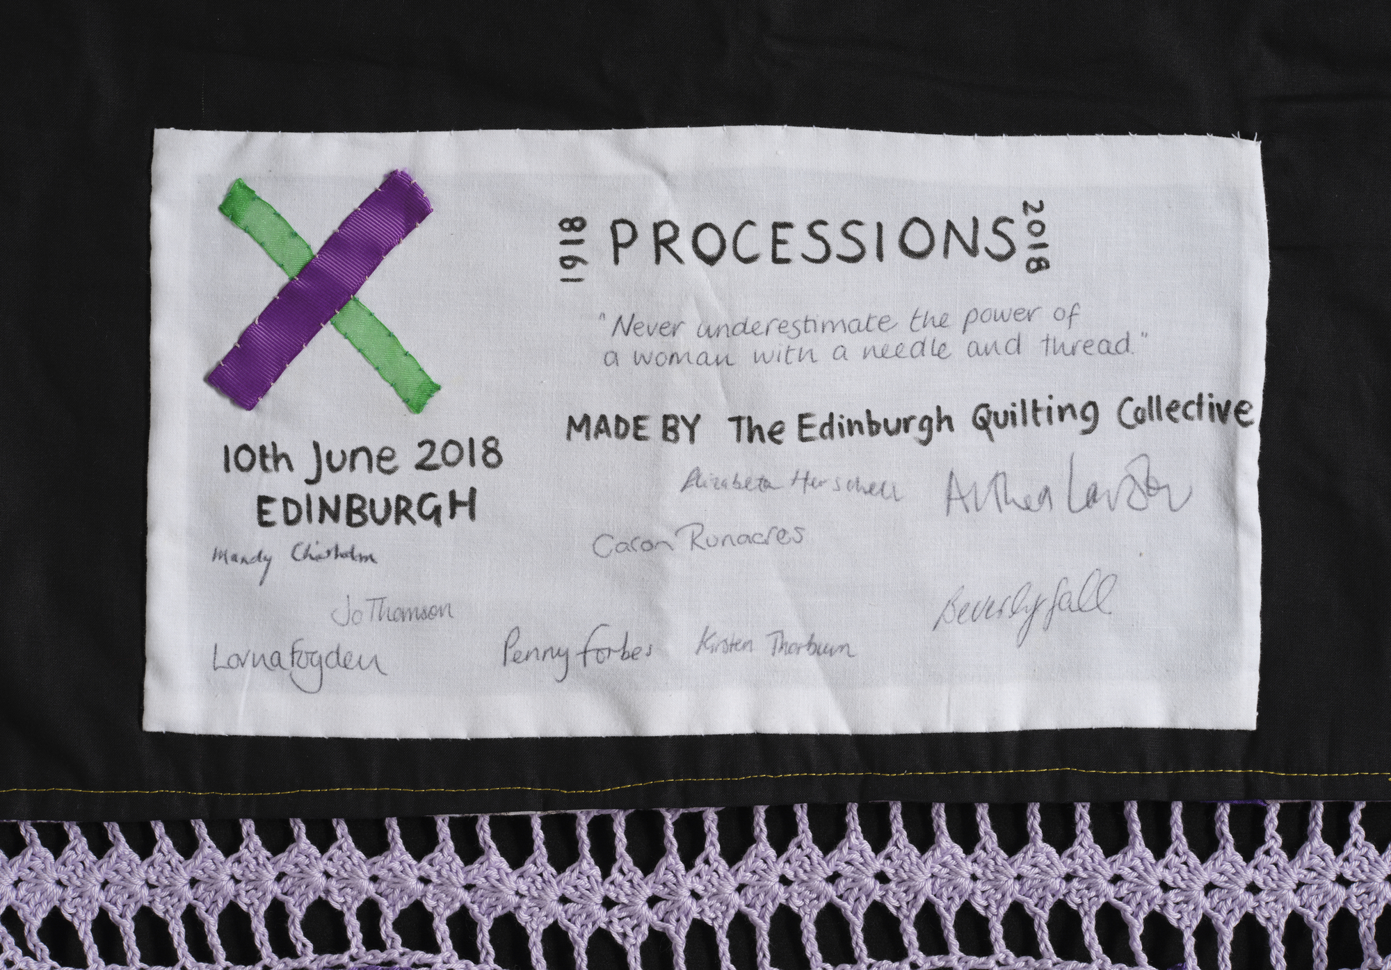
A quilt from the Museum of Scotland
National Museums Scotland cares for this quilt.
A quilted banner, made for the Processions march in Edinburgh on 10 June 2018 to celebrate 100 years of women's suffrage and campaign for gender equality in contemporary society.
Designed by Lorna Fogden and made by The Edinburgh Quilting Collective, Edinburgh in 2018.
Rising Heat, Raising Hope
Climate Change for Kids
Our Quilt
A guide to contributing to the nationwide art project
Image © National Museums Scotland
Image © National Museums Scotland
Notes:
.

Slide 9
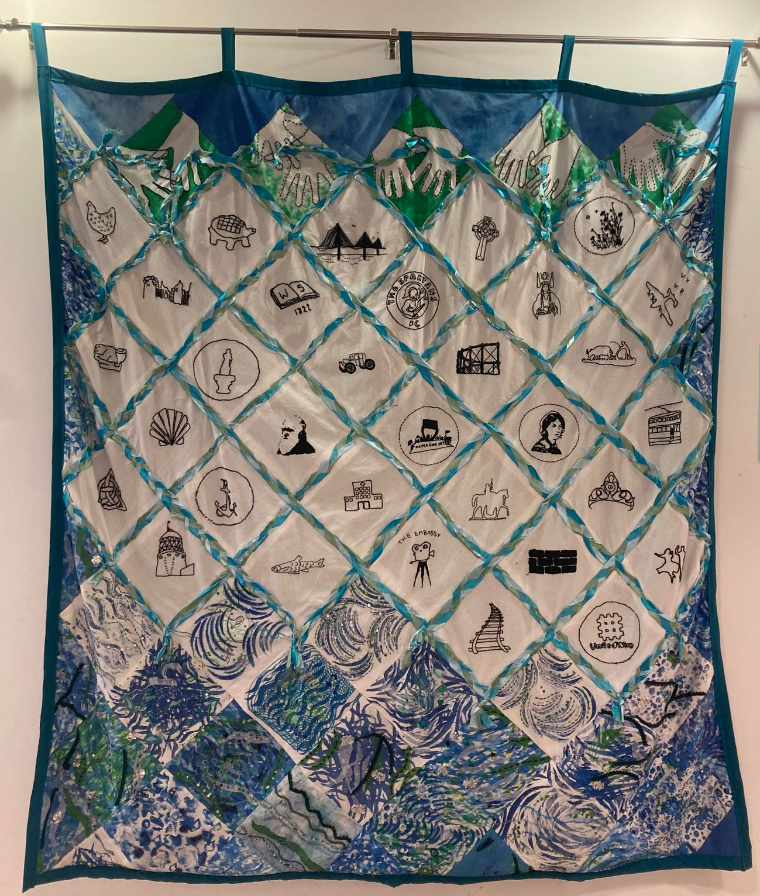
A quilt of history and people
The history banner or quilt was made as part of an arts project to welcome people back into the centre after lockdown.
The banner shows some of the key aspects of the area's history.
The Time for Change Men's History Group researched and came up with symbols to represent some main areas of local history. These ideas were shared with women in the Time for Change Arts and Craft group, who stitched them onto individual squares.
Wee ones and big ones took part in the project, with kids from the After School Club stitching, painting and embellishing the 'sea' along the bottom. Young people from Granton Youth traced and stitched hands to hold up the 'fishing net'. The Spring Chickens painted and added sparkle to the 'sea.'
The project was led by artist, Jessica Howarth. It was funded by the Nancy Massey Fund.
Royston Wardieburn Community Centre, Edinburgh

Slide 10
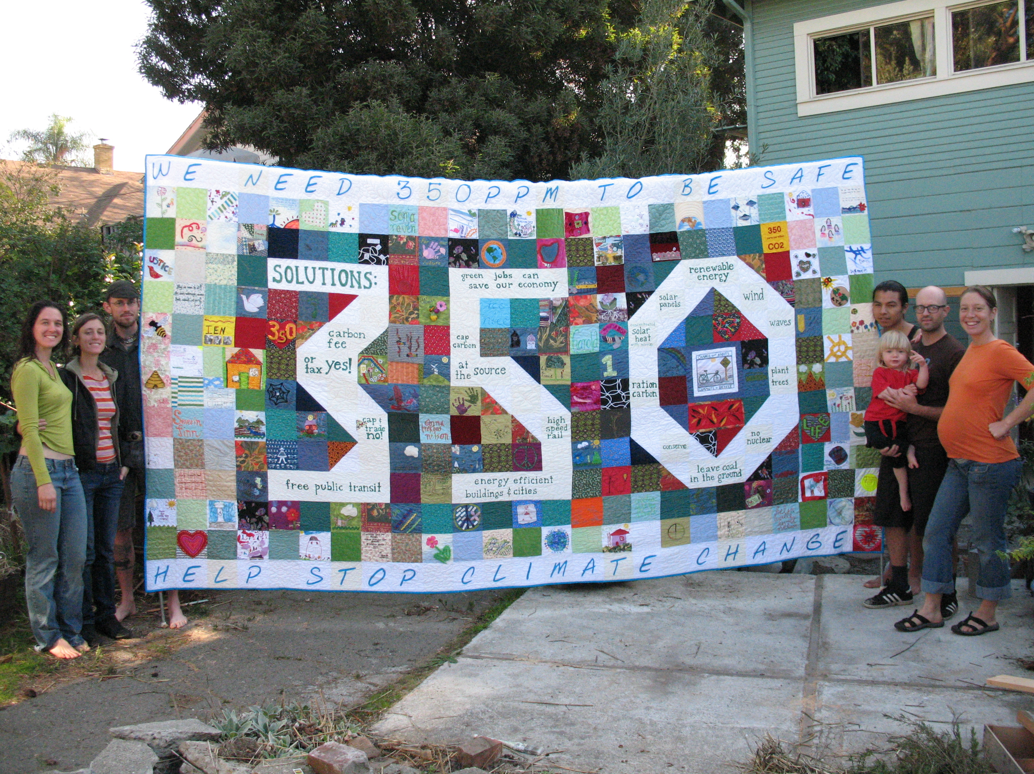
Climate Change Quilt
Image © https://voicesgloucester.org.uk/
The Solutions to Climate Change quilt has 350 pieces, to represent the 350 parts per million of carbon dioxide (CO2) that NASA climatologist James Hansen has said is the maximum safe level of CO2 in our atmosphere. It was created by Ulla Nilsen from America after she started learning more about global warming, and wanted to do something to help her children's chances of having a decent future on this planet.
Ulla wrote to friends and family and asked them to make squares and went to quilt groups like the African American Quilt Guild of Oakland, and the East Bay Heritage Quilters.
She sent a picture of the quilt to President Obama as part of a national day of action on climate change.
Find out more and view the amazing photo gallery: climatesolutionsquilt.wordpress.com/
Image © Ulla Nilsen

Slide 11
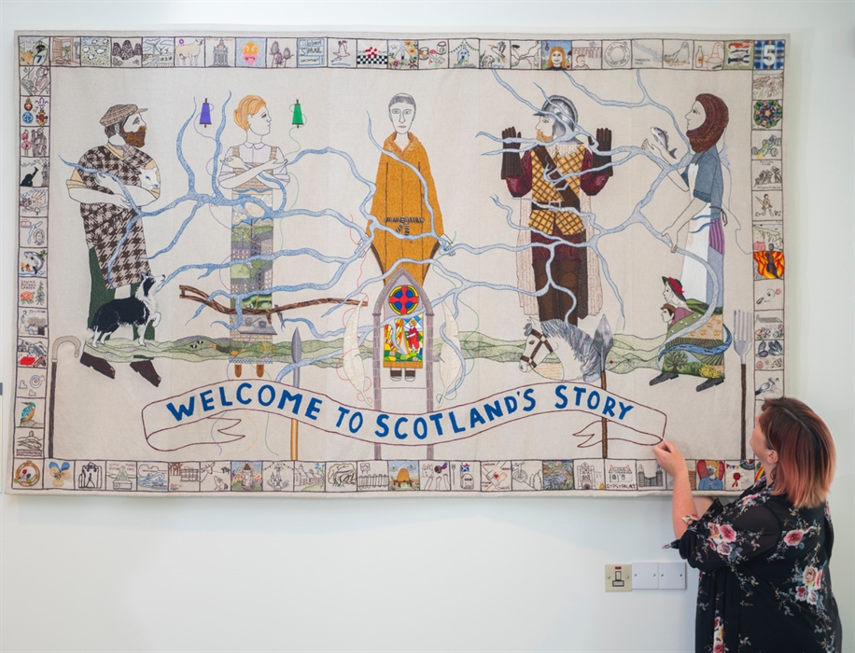
The Great Tapestry of Scotland
The Great Tapestry of Scotland depicts 420 million years of Scotland’s story in 160 panels and is a wonderful, rich and diverse story. It was created and hand stitched by 1,000 people from across Scotland.
Some of the panels reflect on the impact Scotland has had worldwide; the positive and the negative. Others acknowledge the importance of both immigration and emigration, wealth and poverty, but most focus in on the ordinary individual and the micro stories of history.
www.greattapestryofscotland.com/
Image © greattapestryofscotland.com

Slide 12
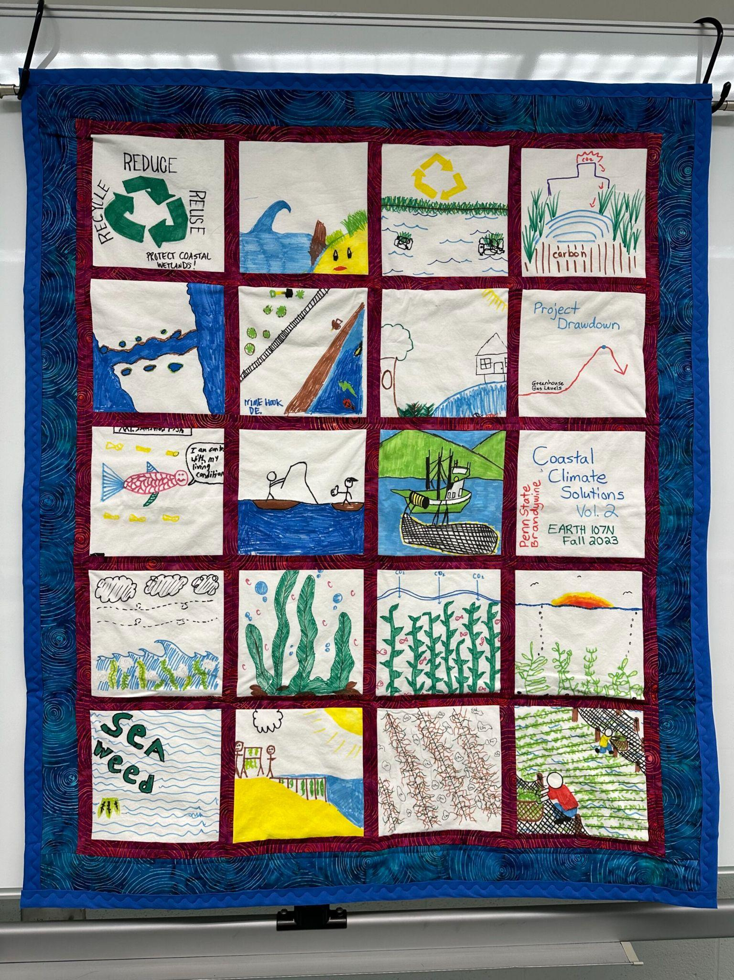
You will need – for fabric squares
Paper and pencil for sketching
Felt square A4 size cut into square
(use the cut-off as scrap to decorate square)
If possible, please use either blue, green, light violet,
yellow, dark grey
Fabric scraps
Scissors
Fabric Glue
You can also add: Fabric Markers
Recycled Wool, Lace, Ribbon, Buttons
Image © Laura Johnson

Slide 13
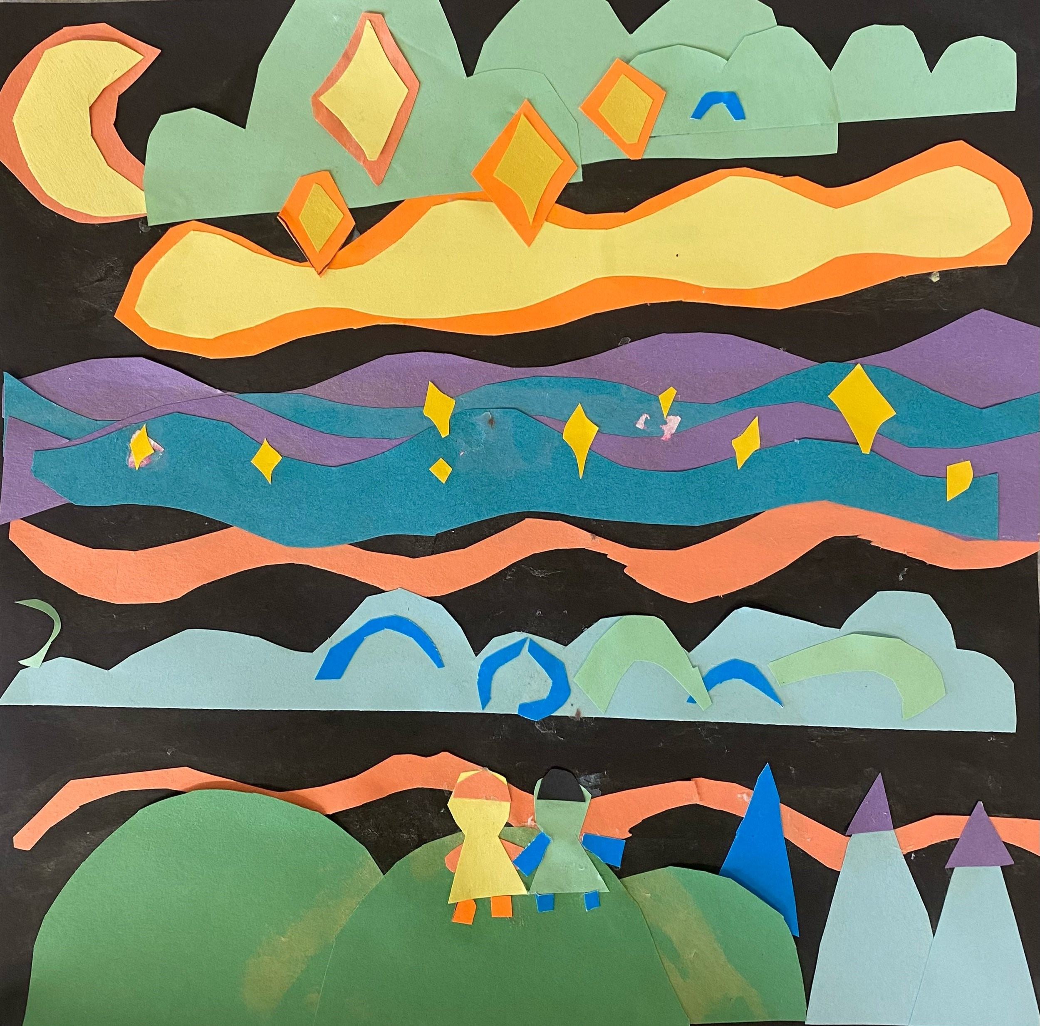
You will need – for paper squares
Paper and pencil for sketching
Paper A4 size cut into square
(use the cut-off as scrap to decorate square)
If possible, please use either blue, green,
light violet, yellow, dark grey
Paper scraps
Scissors
Glue
Image © Laura Johnson

Slide 14
How to make your quilt square
You can choose:
What climate change looks like to you
Your hope for the future
Sketch symbols and images you would like on your quilt square – keep it bold and simple
You might like to include:
What climate change looks like to you
An object
A place
A word
A message

Slide 15
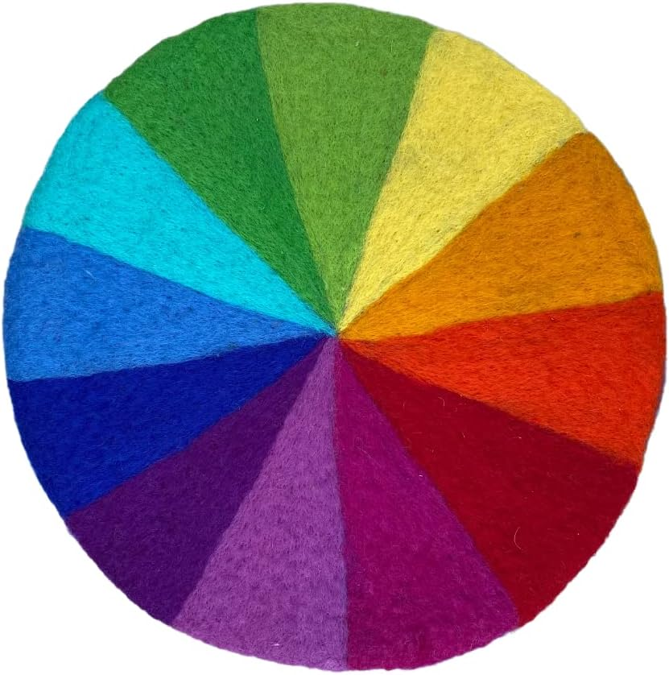
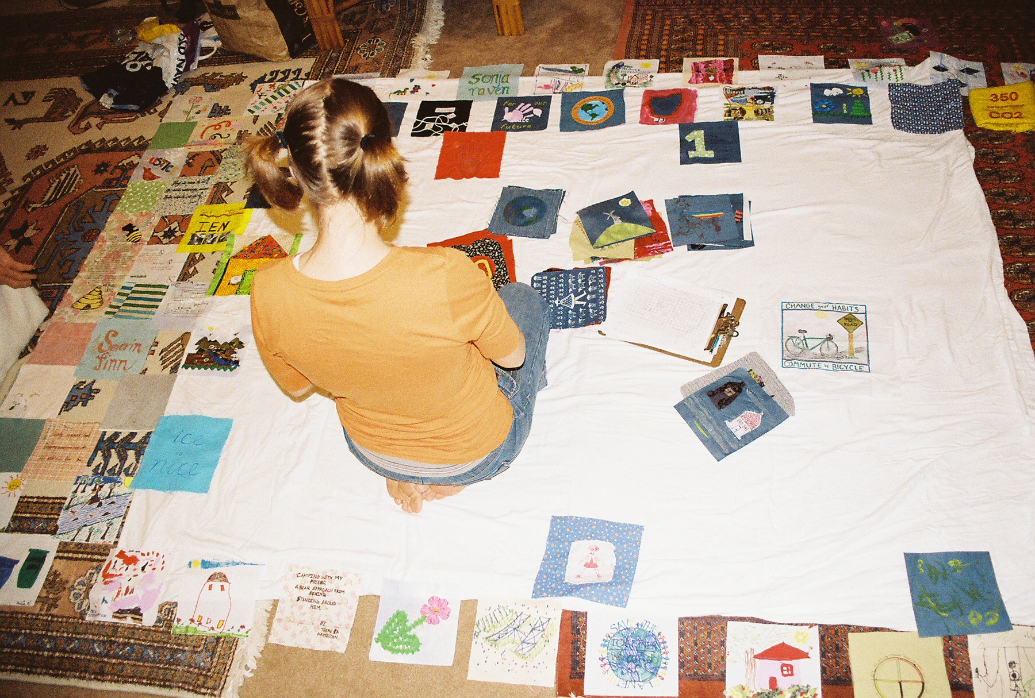
How to make your quilt square
Image © https://climatesolutionsquilt.wordpress.com/
Make your square from fabric or paper. Here’s some instructions from wikihow
Choose the materials you wish to use
Outline and cut out your images from the fabric or paper scraps
Glue your fabric or paper pieces and decorations to your squares

Slide 16
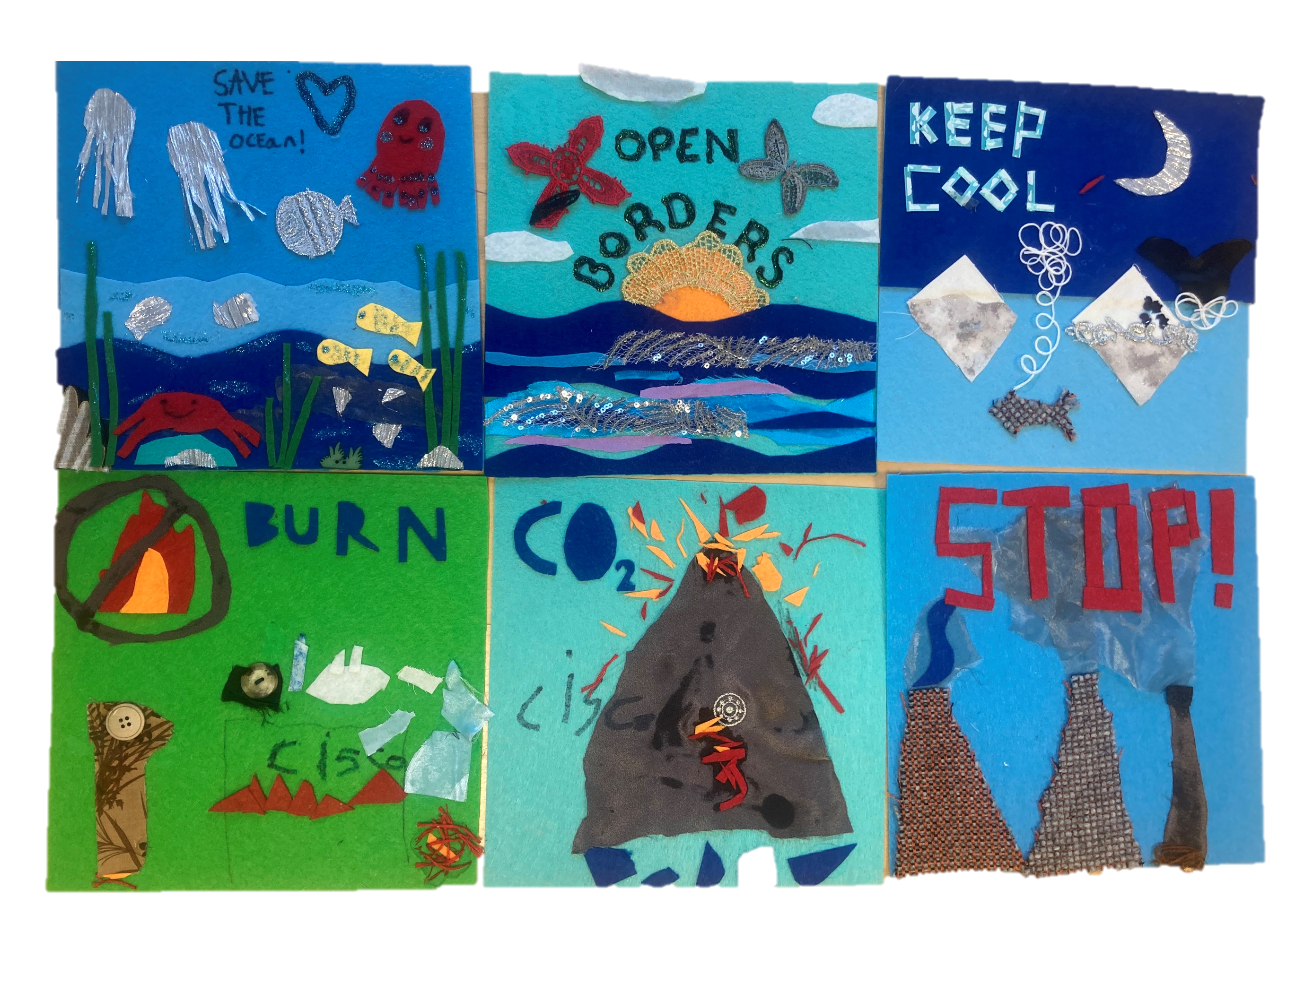
Share your quilt square
Image © https://climatesolutionsquilt.wordpress.com/photo-gallery/
Once the quilt squares are complete, share your work with each other.
Describe the words, symbols, colours and images you used.
What does climate change look like to you?
What is your hope for the future?

Slide 17
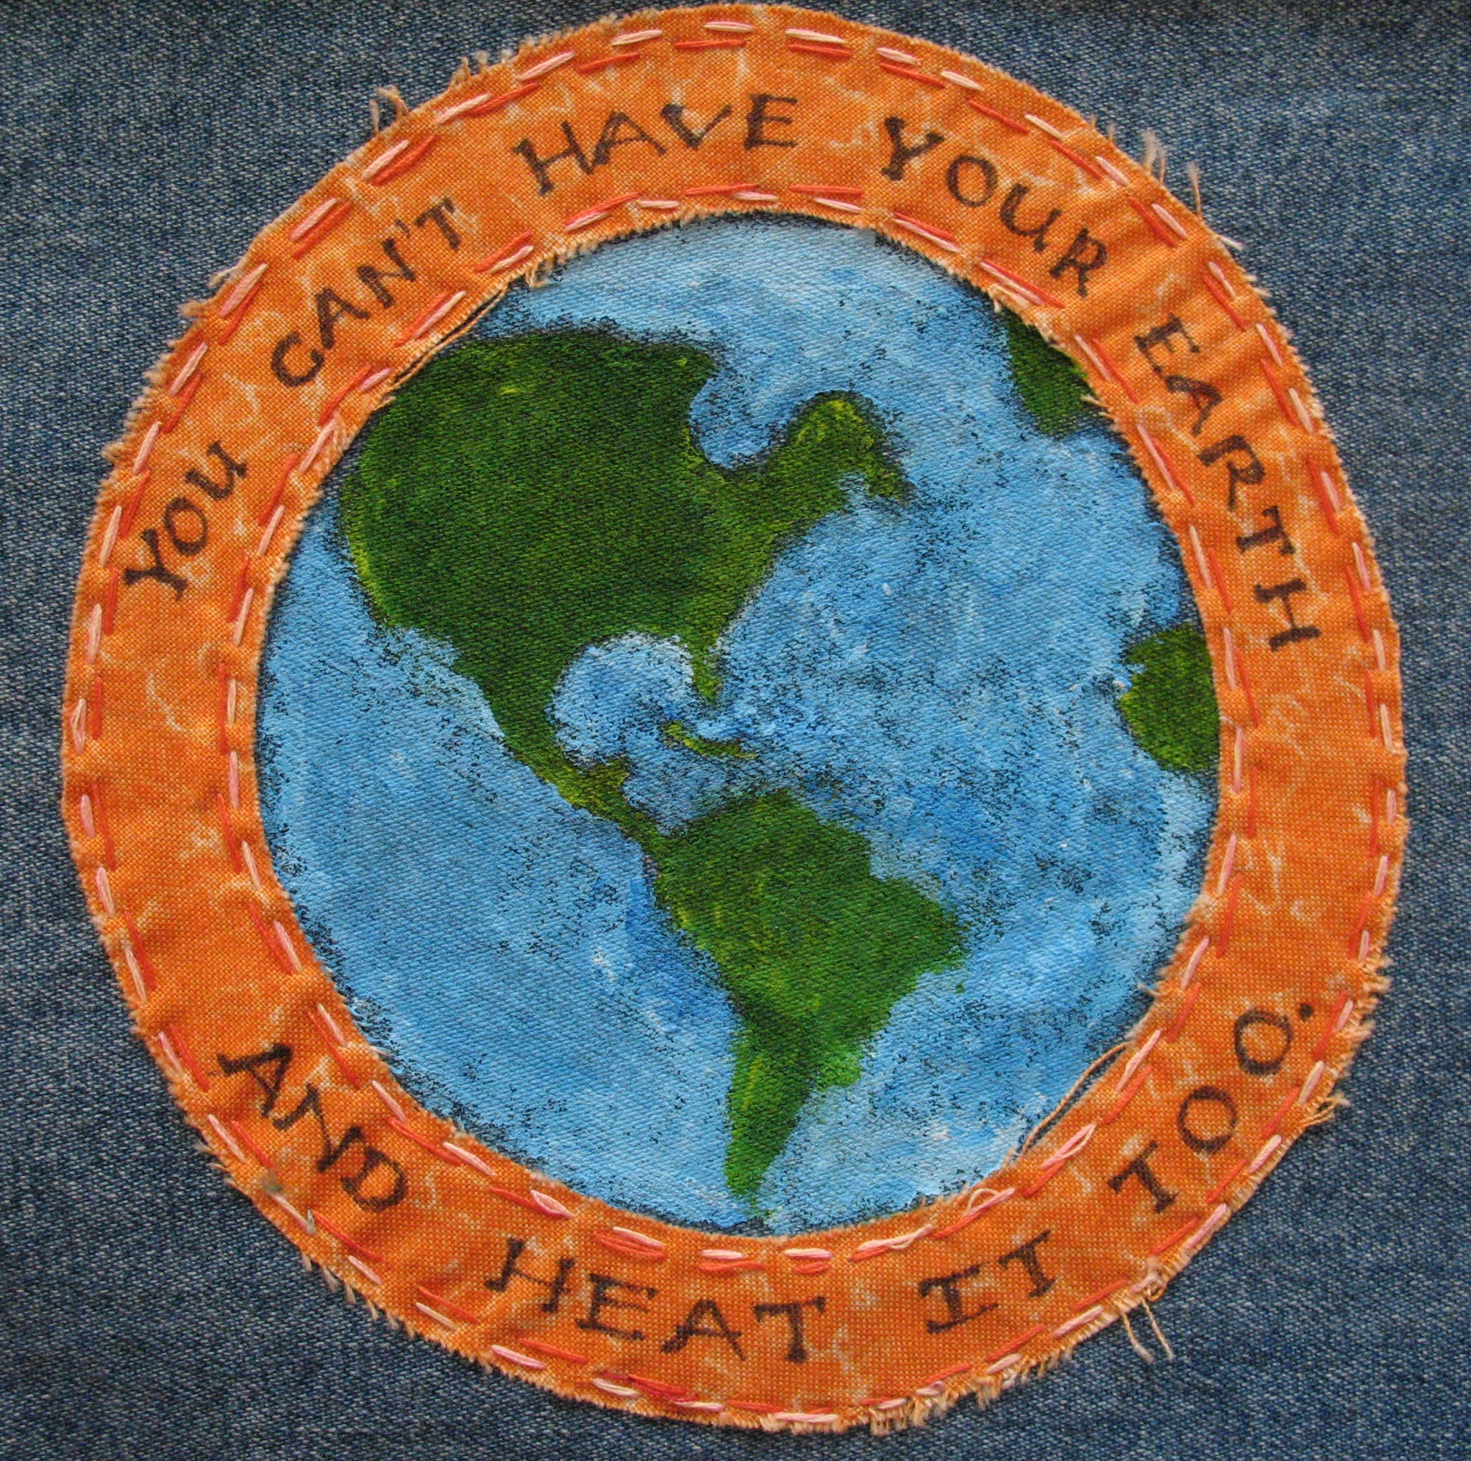
Submit your quilt square
Thank you for being a part of
Rising Heat, Raising Hope
Deadline to submit quilt squares 1 June 2024
Fabric quilt squares:
Attention Ashley Mackenzie-White
National Museums Scotland
Chambers Street
Edinburgh
Paper quilt squares – send your scanned images to:
schools@nms.ac.uk
Image © Laura Johnson
Image © https://climatesolutionsquilt.wordpress.com/photo-gallery/

Slide 18
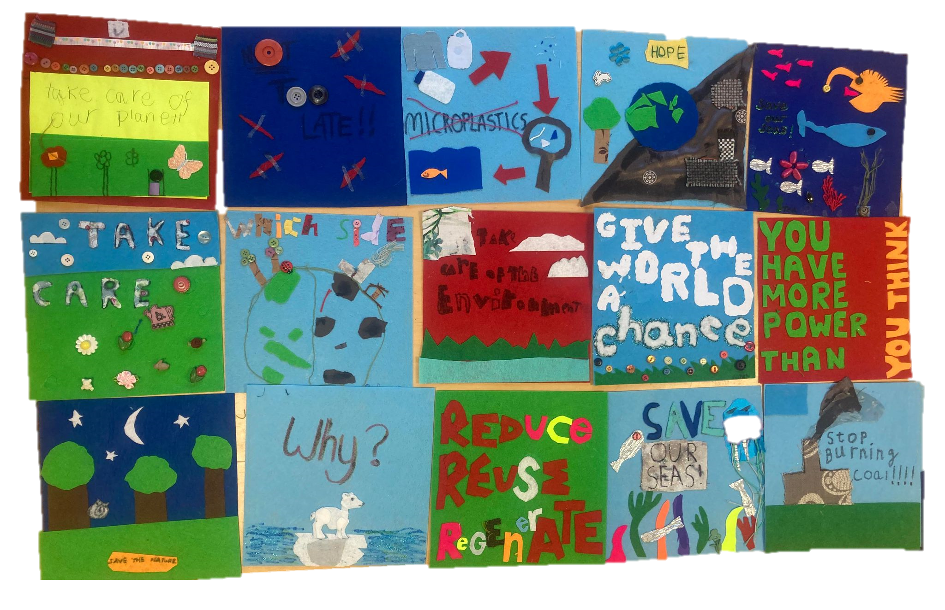
Quilt squares made in community workshops

Slide 19
Learning resources for schools:
www.nms.ac.uk/SchoolsClimate
Including three short films, accompanying teachers’ notes and worksheet exploring the climate emergency, our role and choices surrounding it and how it links to a variety of careers: www.nms.ac.uk/ClimateFilms
© National Museums Scotland, Scottish Charity, No. SCO11130

