Slide 1
The Atlantic slave trade: Investigating primary sources
The abolitionist campaigns

Slide 2
Trigger warning
The following presentation contains images of objects which relate to the treatment of enslaved people and explores themes which may be upsetting.

Slide 3
Introduction
The anti-slavery movement began to gain momentum in Britain towards the end of the 18th century, with numerous abolitionists sharing experiences of slavery and having connections to Scotland.
Abolitionist arguments fell into three categories – economic (it was costly), humanitarian (it dehumanised), and Christian (people should be treated with kindness and love).
Use this PowerPoint alongside The abolitionist campaigns resource sheet to explore objects in our collections as primary sources of evidence.

Slide 4
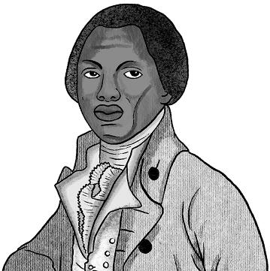
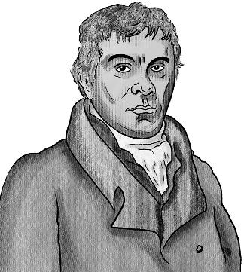
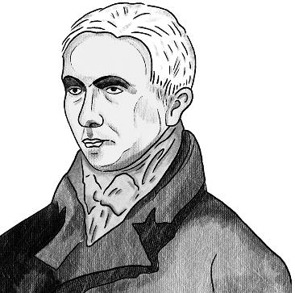
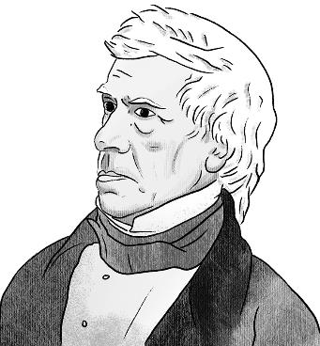
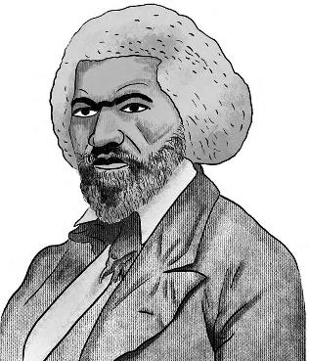
Who were the abolitionists?
Abolitionists were people who sought the abolition of the slave trade.
A number of them had connections with Scotland, including:
Olaudah Equiano
Robert Wedderburn
Zachary Macaulay
Henry Brougham
Frederick Douglass

Slide 5
Initial discussion
In pairs or groups, discuss what you already know about the abolitionists.
What different methods did they use to achieve their goal of ending the slave trade?

Slide 6
Objects as evidence
One of the methods used by abolitionists was to present and produce objects which highlighted the horrors of the slavery system.
The following slides in this presentation will explore some of these objects.

Slide 7
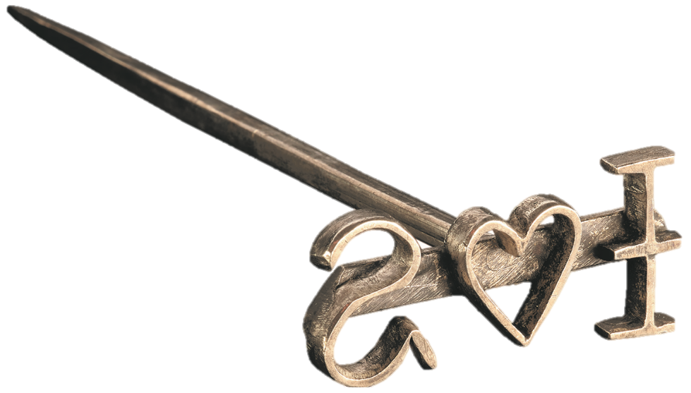
The abolitionist campaigns
Object one
Dimensions:
Length: 11.0cm
Width: 6.0cm

Slide 8
Exploring the object
What do you think it is made from?
What can you see? How would you describe the object?
What is unusual about the letters?

Slide 9
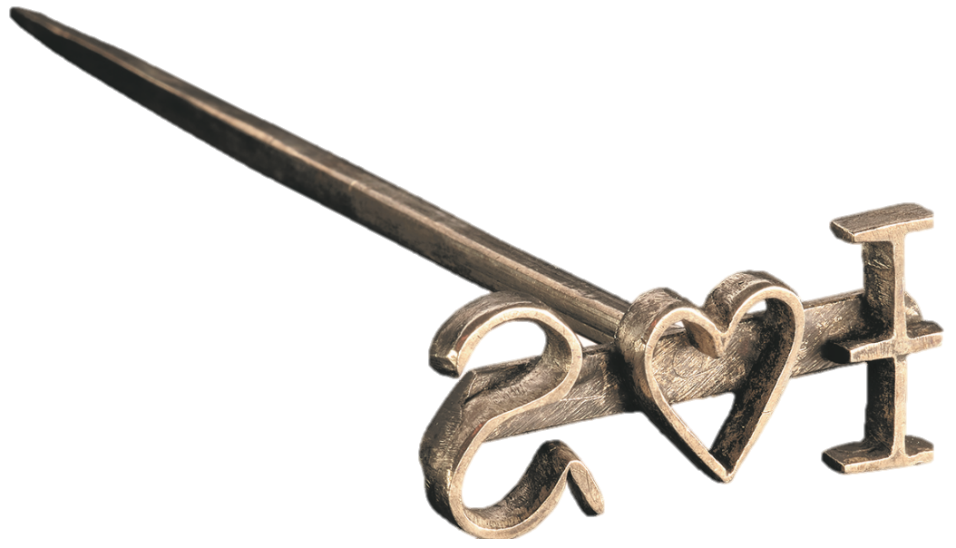
What is this object?
Said to have been a BRAND, from St George, West Indies.
Brands were used to mark enslaved people.
The initials I.S. were most likely those of the enslaver.
The heart symbol was commonly used on different types of objects, sometimes indicating property.
Please use The abolitionist campaigns resource sheet (page 3) for further information about the brand.

Slide 10
Discussion questions
Please use The abolitionist campaigns resource sheet (page 3) for further information to support your discussions.

Slide 11
What does the use of the brand tell us about the status of enslaved people and how their humanity was viewed?

Slide 12
Why might objects like the brand be effective tools for the abolitionist cause?
What impact did abolitionists want to have on their audience?

Slide 13
Which group of abolitionist arguments – economic, humanitarian or Christian – do you think this object would most support and why?

Slide 14
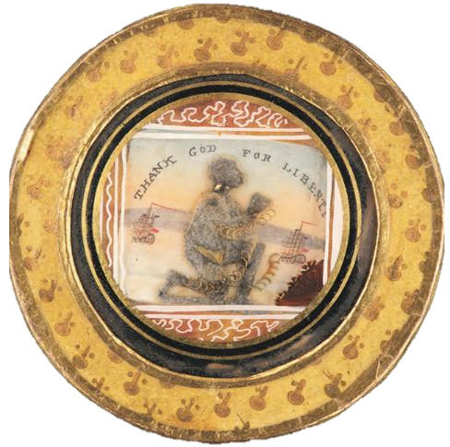
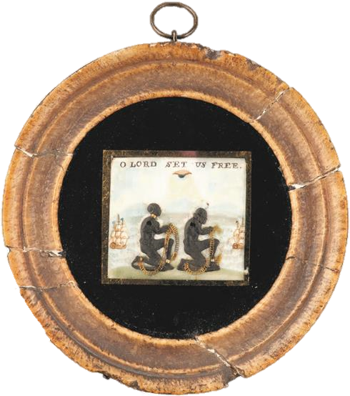
The abolitionist campaigns
Objects two and three
Diameter: 6.4cm
Diameter: 10.5cm

Slide 15
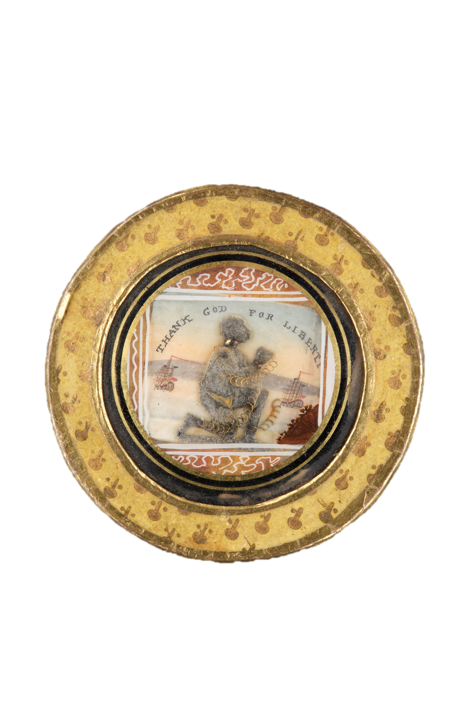
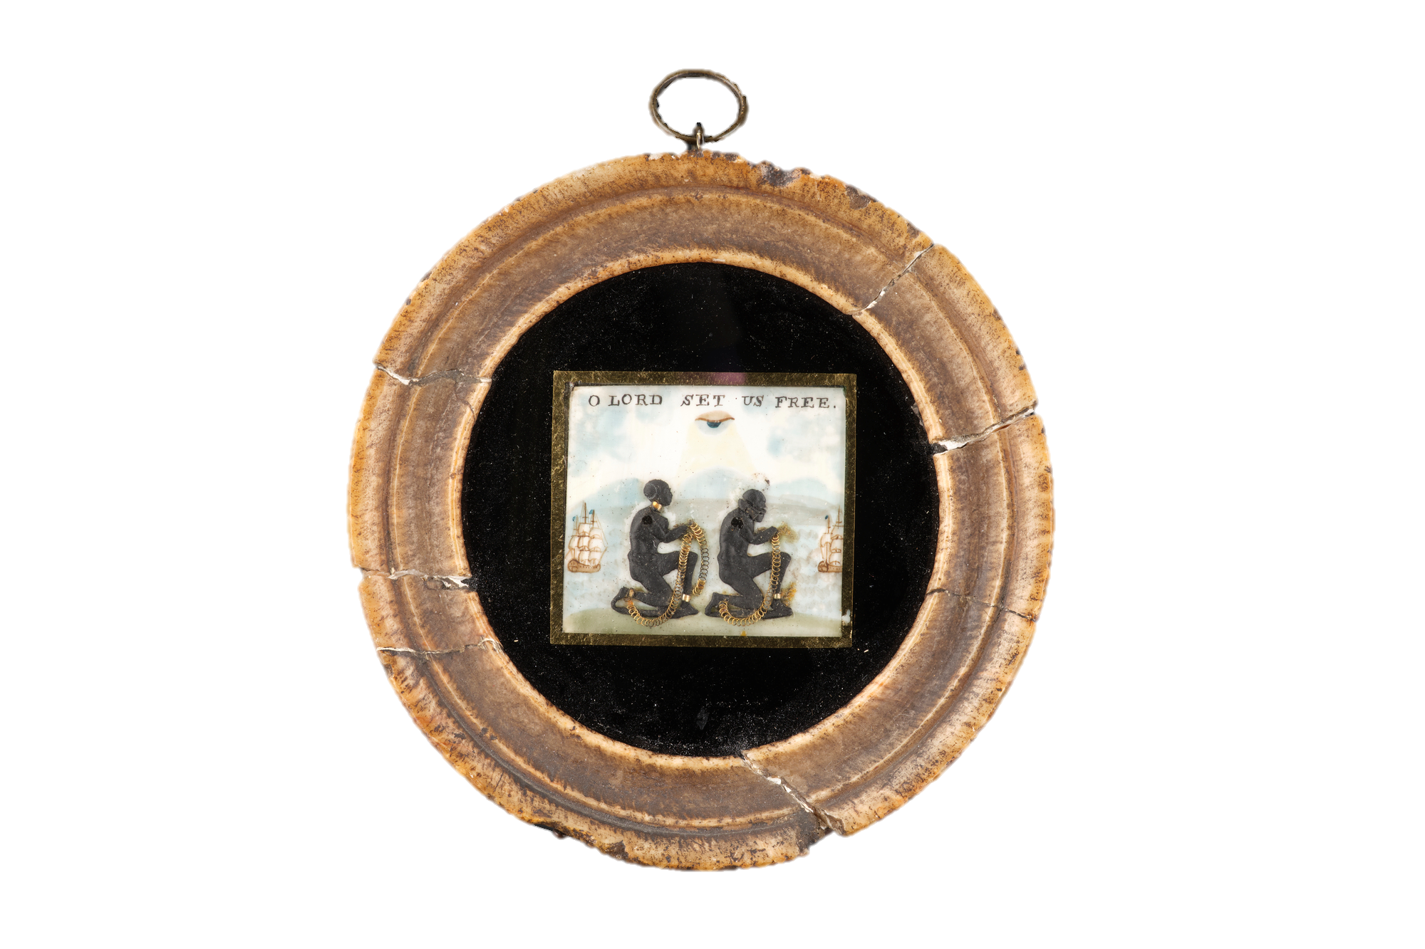
Exploring the objects
Do they remind you of anything?
How would you describe these objects?
How do you think they might be used?
What images can you see in the objects?

Slide 16
Anti-slavery ivory plaques, early 19th century.
What are these objects?
They show enslaved people kneeling with shackles and chains, with trade ships in the distance.
One reads 'THANK GOD FOR LIBERTY', the other, 'O LORD SET US FREE', with a watchful eye above.
Please use The abolitionist campaigns resource sheet (page 4) for further information.​

Slide 17
Discussion questions
Please use The abolitionist campaigns resource sheet (page 4) for further information to support your discussions.

Slide 18
Ornaments, plaques and fashion accessories were used as visual symbols to publicly declare support for a cause.
Can you think of any modern-day equivalents?
If the plaques were created today, do you think the imagery used would be different.

Slide 19
Which group of arguments against the slave trade – economic, humanitarian and Christian - do you think these plaques support?

Slide 20
Religious imagery would have been very familiar to people in the early 19th century.
What images and symbols can you see on the plaques which would have been recognised by a Christian audience?
Why do you think the
figures were depicted in this pose?

Slide 21
The style of imagery used on these plaques created an idea of enslaved people as passive victims waiting to be saved. This can now be viewed as problematic and unrepresentative.
Enslaved people did resist and fight against slavery – in what ways do you think they did this?

Slide 22
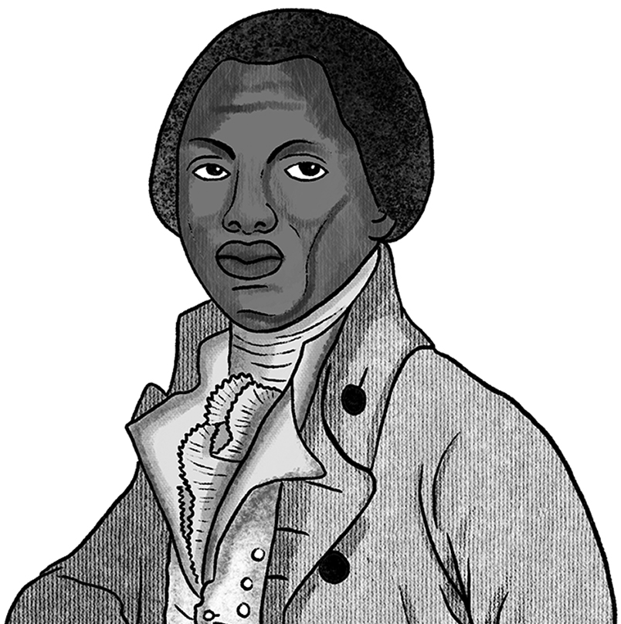
Research
Research the work of formerly enslaved abolitionists such as Olaudah Equiano, Ottobah Cugoano, Mary Prince and Ignatius Sancho.
OR
Research the organisation 'Sons of Africa', considered to be Britain's first black political organisation.

Slide 24
The next three slides contain the following additional materials to support classroom learning:
Higher resolution images of the key objects
Optional timers to use for the group discussions

Slide 27
Optional timers for discussion questions
2 minutes
3 minutes
4 minutes
5 minutes
Timers provided by Training and Consultancy Ltd.
To use, select both elements of the timer (written minutes and circle) and paste to required slide.
The timer will begin on mouse click.

