Slide 1
My visit to the National Museum of Scotland

Slide 2
My name is ……………….
I am visiting the National Museum of Scotland on
I will be setting off at

Slide 3
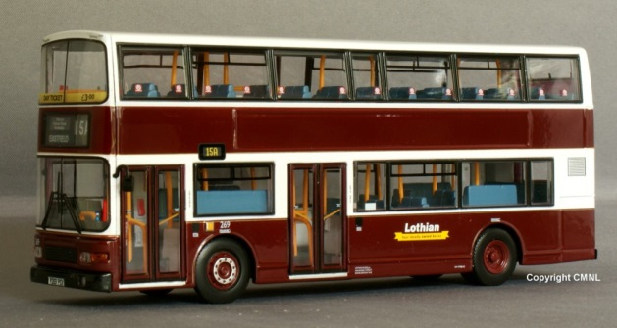
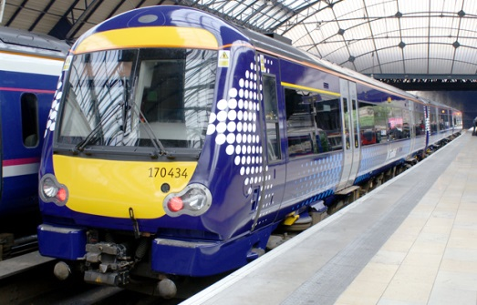
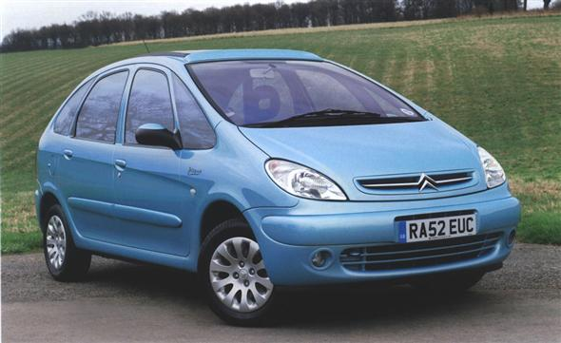
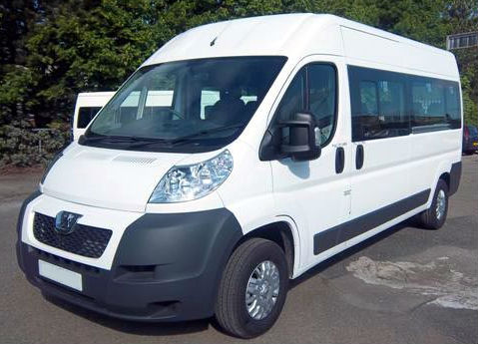
I am travelling to the museum by…
Bus
Train
Walking
Car
Coach
Minibus

Slide 4
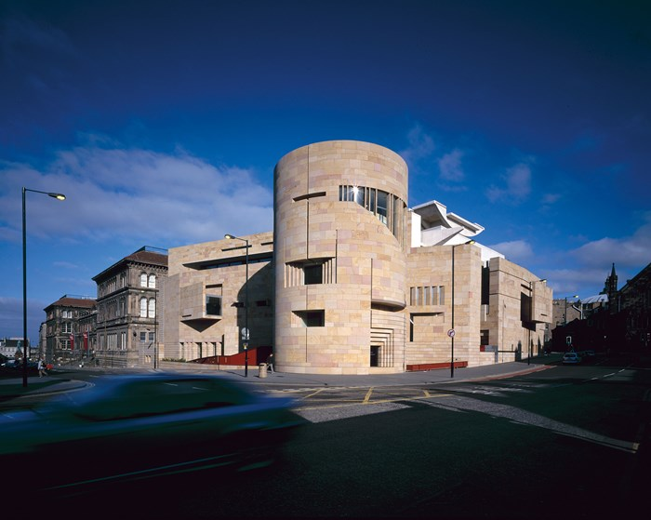
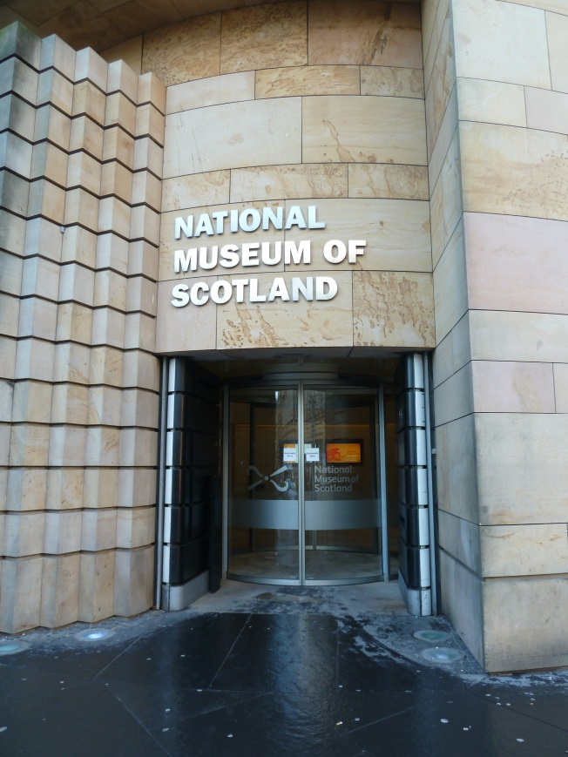
I will go into the museum through the Tower Entrance.
The museum is free and I can start exploring straight away.
The door will open automatically.
Notes:
Do we want to direct people into the Tower Entrance instead – backpacks and quieter area?

Slide 5
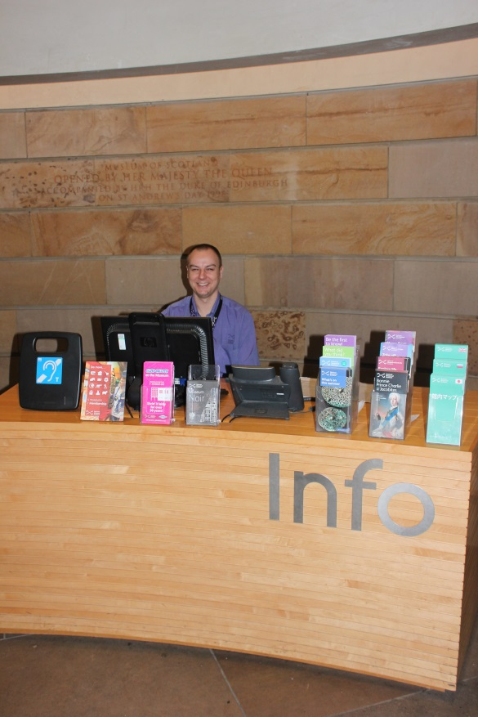
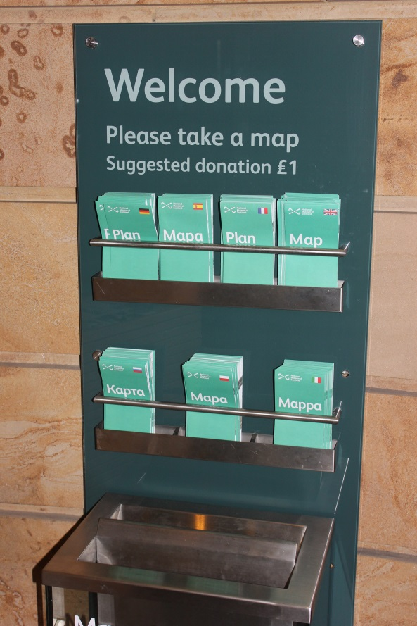
The Tower Entrance has a desk with a Visitor Experience Assistant.
I can ask them questions about the museum and pick up a map to help find my way around.

Slide 6
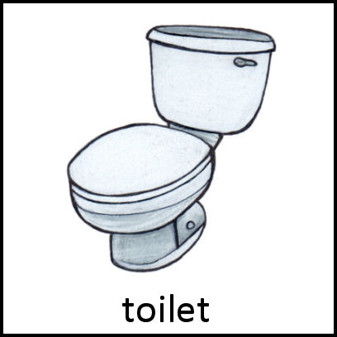
There are toilets near the Entrance.

Slide 7
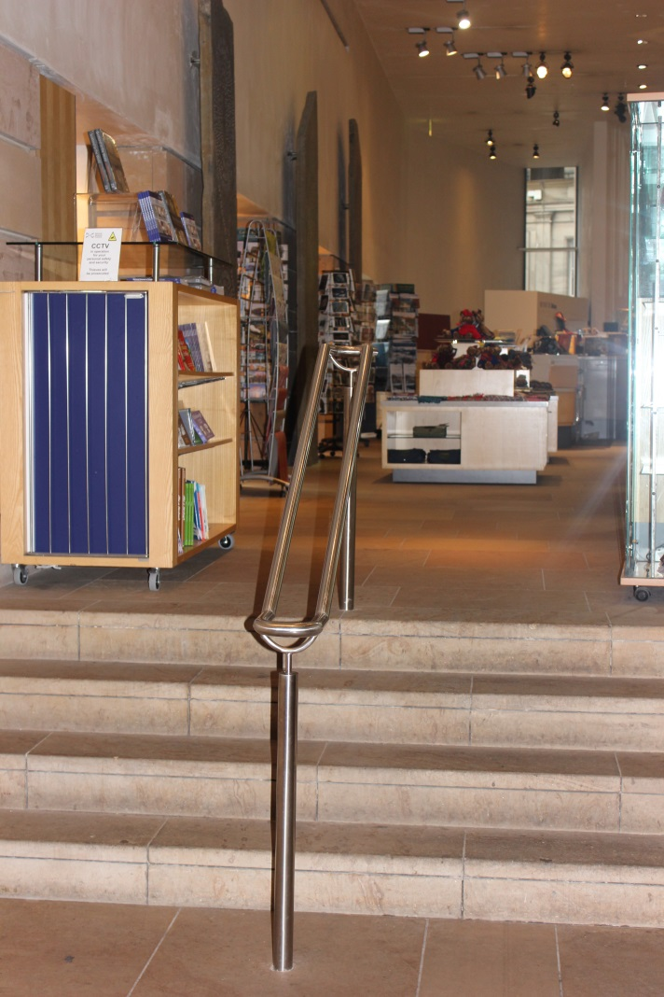
When I go along the corridor I will walk past a shop.

Slide 8
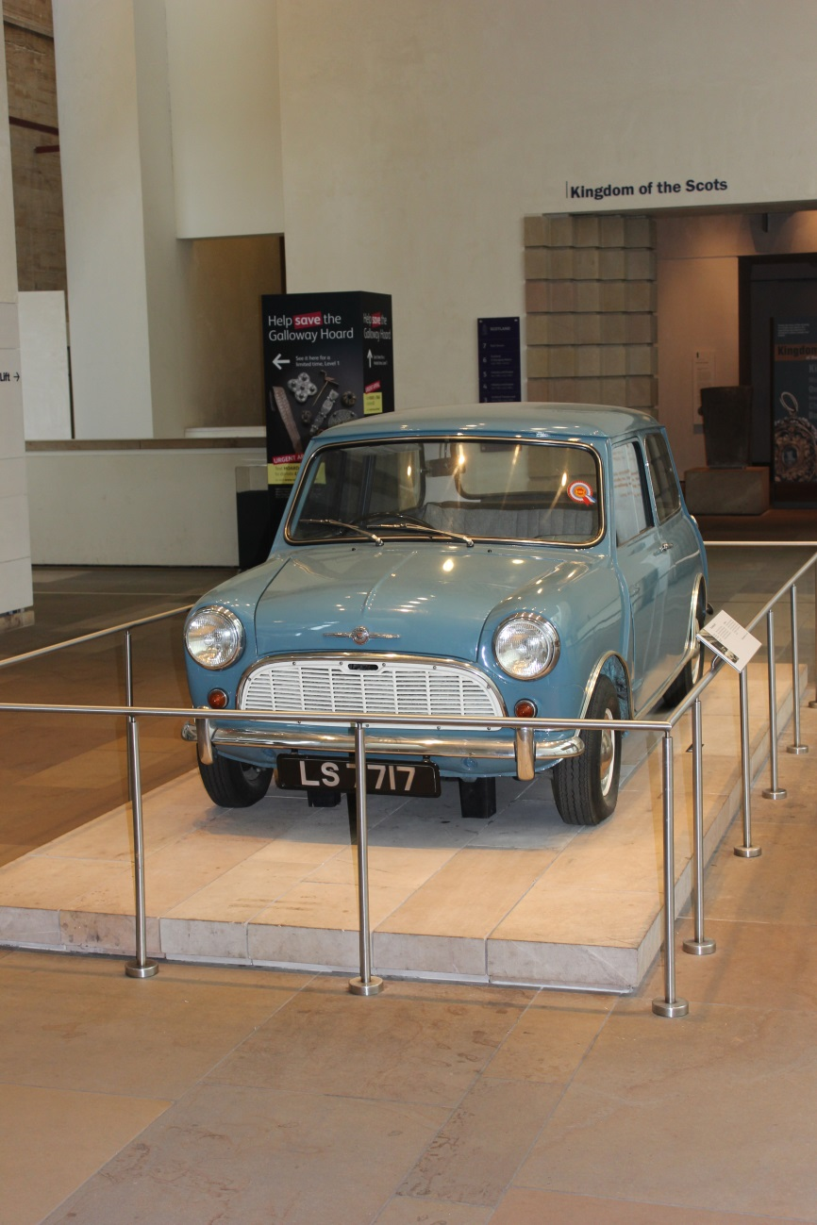
Then I will see a car.

Slide 9
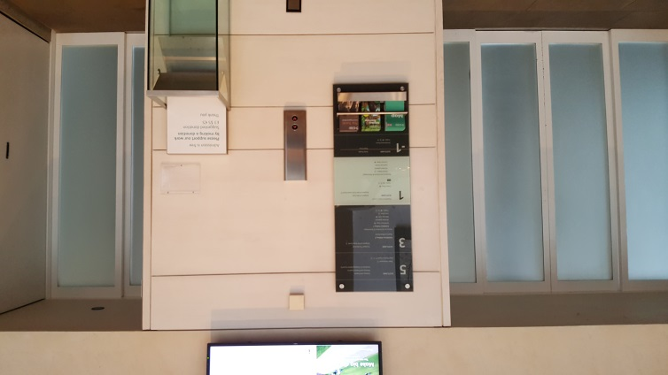
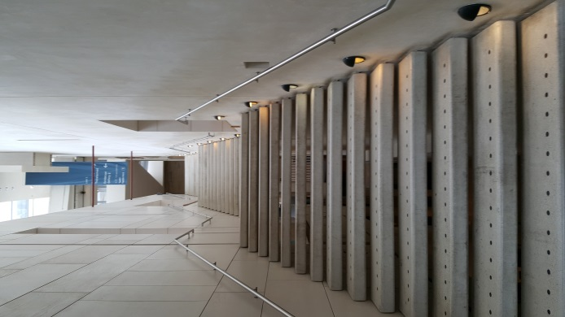
I can go upstairs or use the lifts to explore the galleries about Scotland.
Lift
Stairs

Slide 10
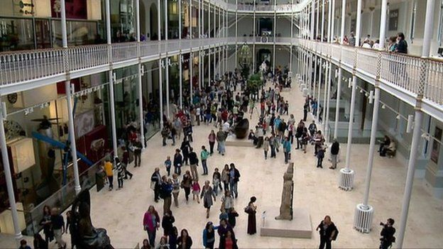
Or go into the Grand Gallery. It can be busy and people might be talking.

Slide 11
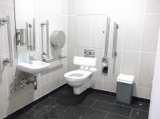
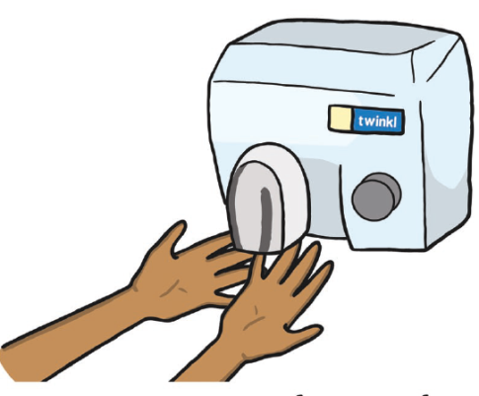
There are accessible toilets underneath the stairs on every level of the Grand Gallery and balconies.
The hand dryers are very loud.

Slide 12
The museum has lots of different things in it. It has objects to do with…
SPACE
SCOTLAND
ANIMALS
FASHION
ART AND DESIGN
AND THINGS FROM ALL ACROSS THE WORLD
SCIENCE AND TECHNOLOGY

Slide 13
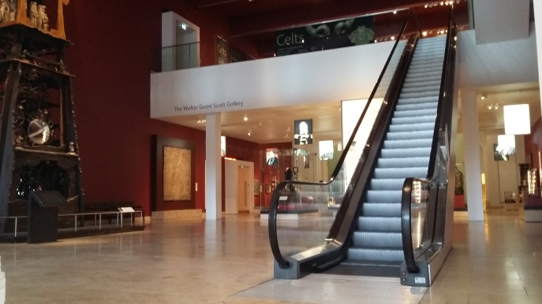
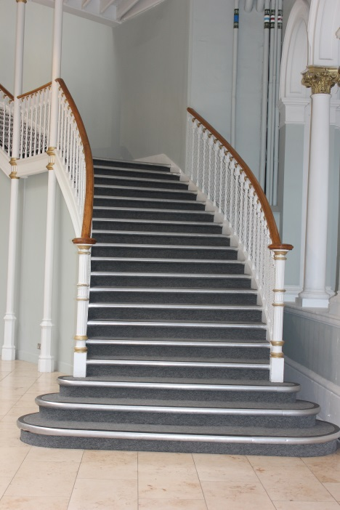
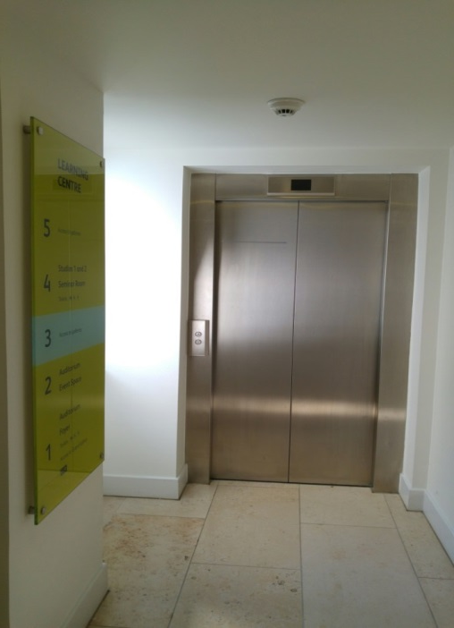
I might need to use stairs, a lift or an escalator to go upstairs to see things.
Escalator
Lift
Stairs

Slide 14
While I am at the museum I might….

Slide 15
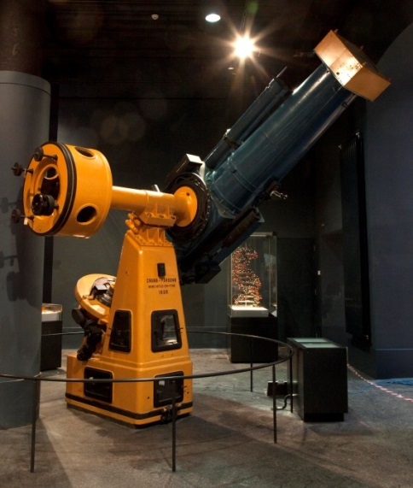
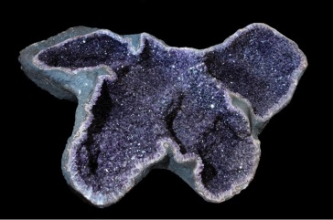
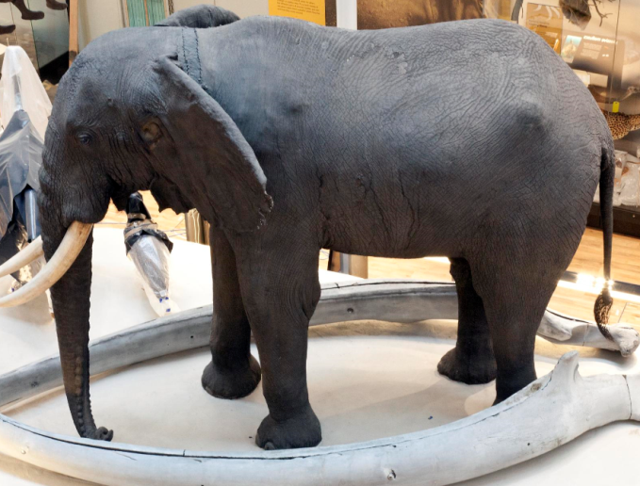
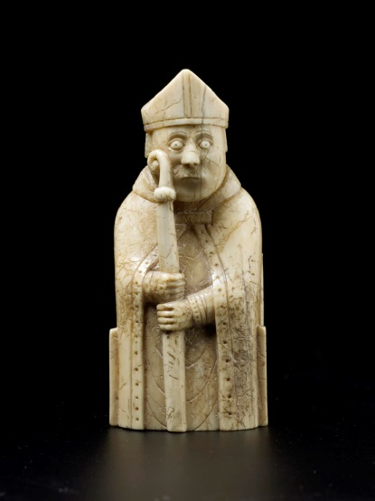
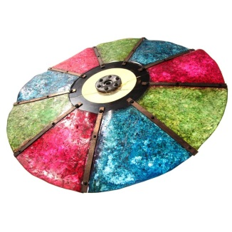
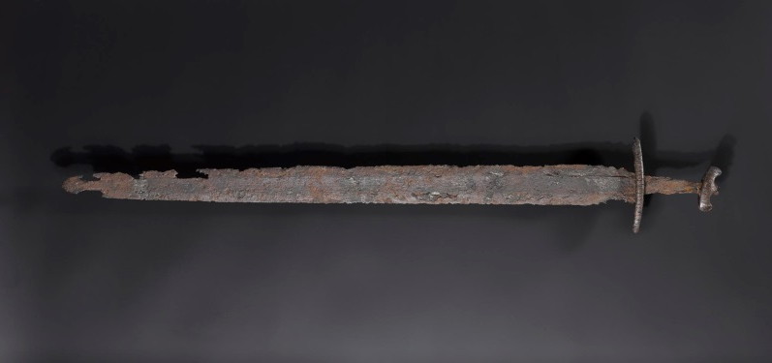
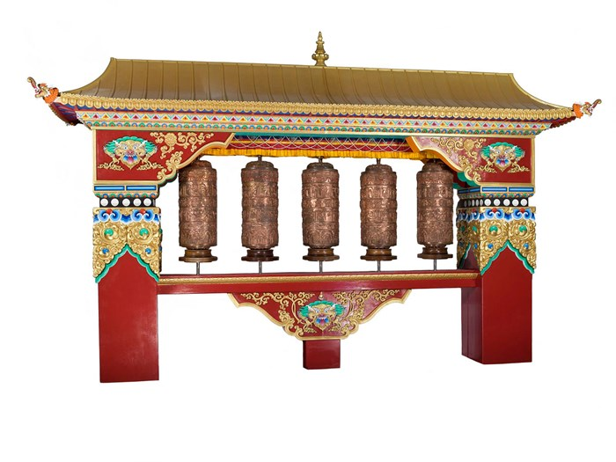
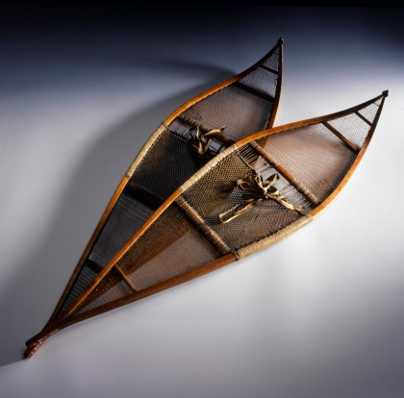
See lots of interesting things.
Some will be things I have seen before and some might be different.

Slide 16
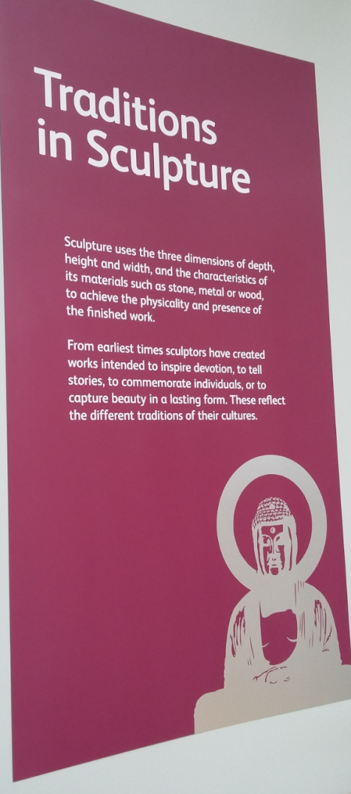
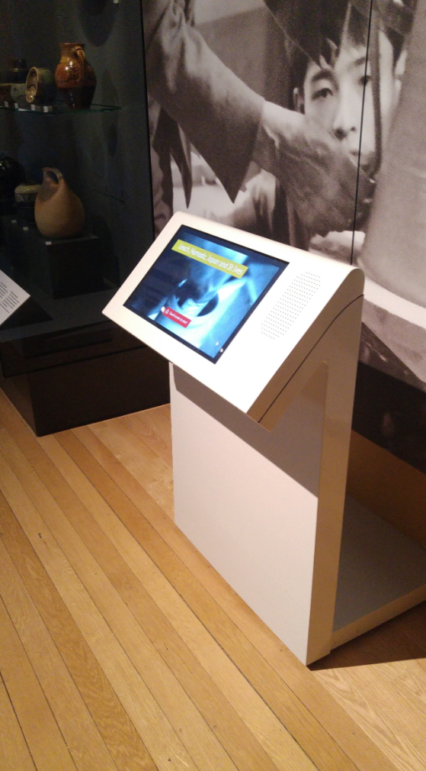
I can find out more about them.
Panels on the wall and labels in the cases will tell me about the things I see.
Or there might be touchscreen computers where I can find out more.

Slide 17
I might hear…
Other people talking, shouting and laughing
Music from the Millennium clock or from musical instruments
Beeps, whirring and clanking from some of the machines

Slide 18
I might get to touch some objects
If you see the ‘please touch’ sign on an object then you can touch it!
If not, don’t touch it!

Slide 19
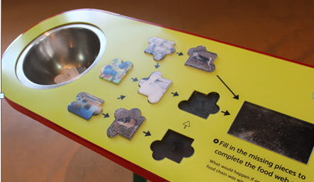
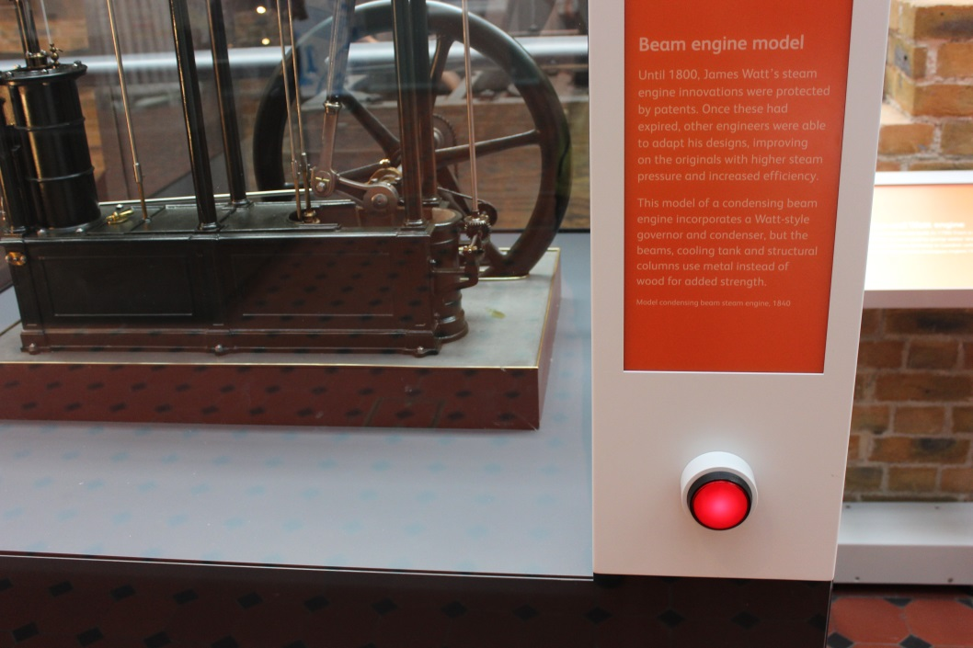
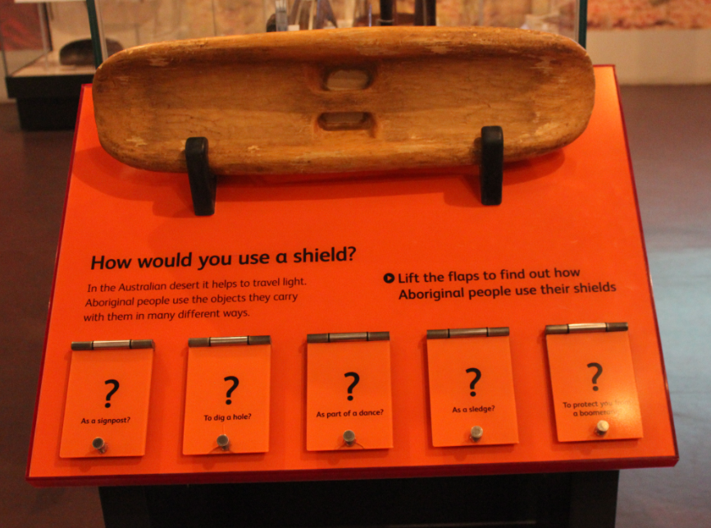
Or press buttons to make things move and play games.

Slide 20
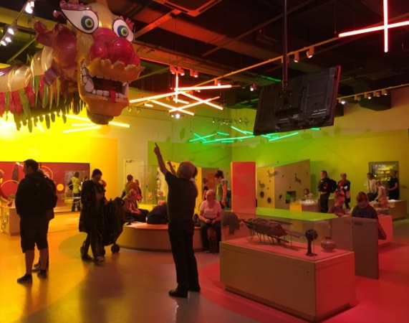
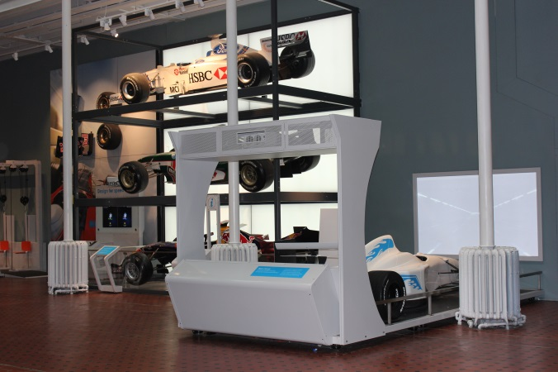
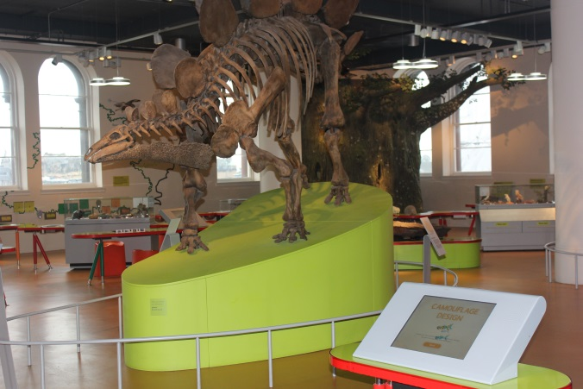
There are some galleries that were designed for families. They are fun and have lots to play with but they can be busy.
Imagine, Level 1
Explore, Level 1
Adventure Planet, Level 5
There are lots of exciting things in the rest of the museum too.

Slide 21
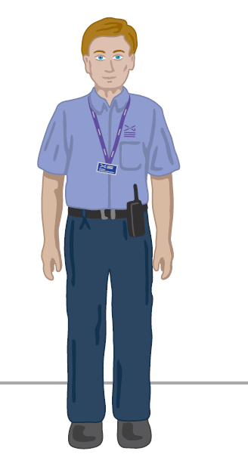
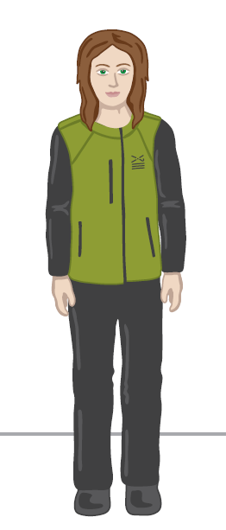
If I need a break or want to ask a question about the museum I can talk to someone who works at the museum. They wear uniforms that look like this:
Learning Enabler
Visitor Experience Assistant

Slide 22
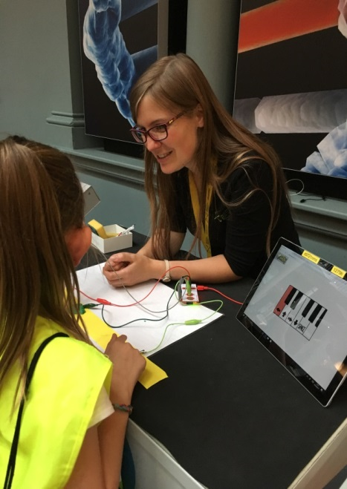
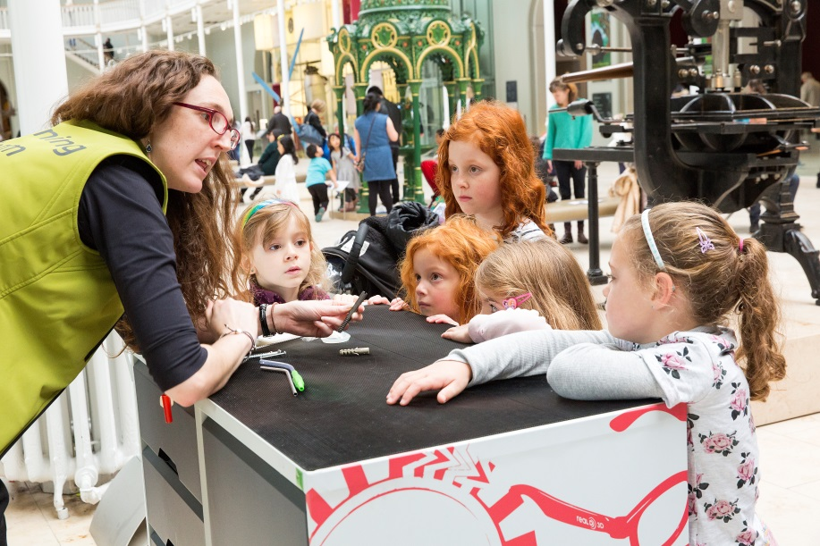
Sometimes the Learning Enablers will be showing people objects, science demonstrations or craft activities.
You can join in if you want to.

Slide 23
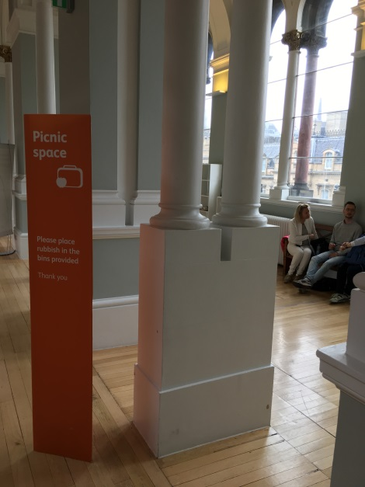
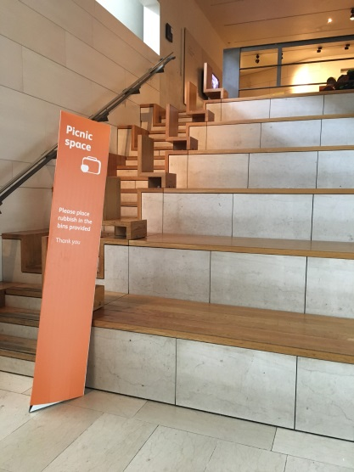
We are only allowed to eat in certain places in the museum.
Staff can help us find an eating space if we need one.
Level 3 (next to the Balcony café)
Level 4 Scottish galleries (Industry and Empire) – this is next to a locomotive

Slide 24
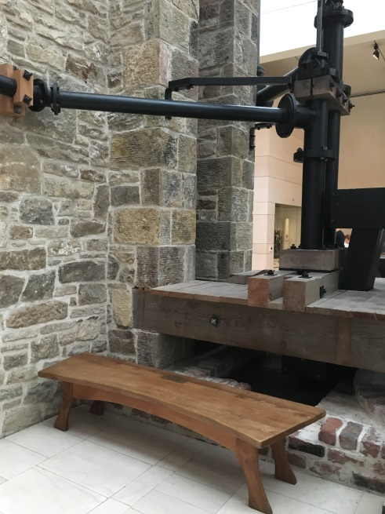
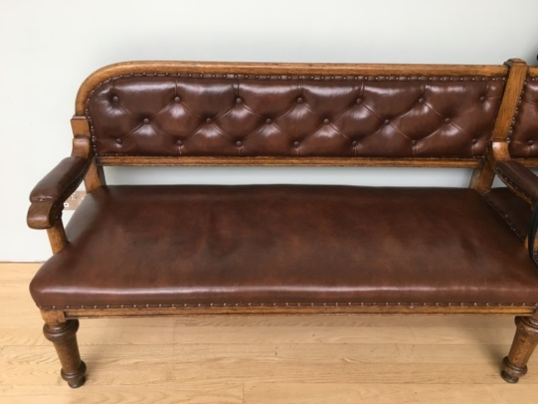
If I need some time out or a sit down these are some good places to go.
I need a break
Or I can tell a member of staff I need a break and some quiet time.
Traditions in Sculpture benches (Level 5)
Newcomen Engine bench (Scottish galleries, Level 3)

Slide 25
We hope you have lots of fun!

Slide 26
For more information…
About resources and events for autistic children/young people: http://www.nms.ac.uk/national-museum-of-scotland/plan-your-visit/events-and-resources-for-people-with-autism/
About planning your visit: http://www.nms.ac.uk/national-museum-of-scotland/plan-your-visit/
About the galleries and what you can see: http://www.nms.ac.uk/national-museum-of-scotland/discover-the-museum/
About events and ‘What’s on’ at the Museum: http://www.nms.ac.uk/national-museum-of-scotland/whats-on/
About Disabled Access: http://www.disabledgo.com/access-guide/national-museums-scotland/national-museum-of-scotland-international-gallery-2

