Slide 1
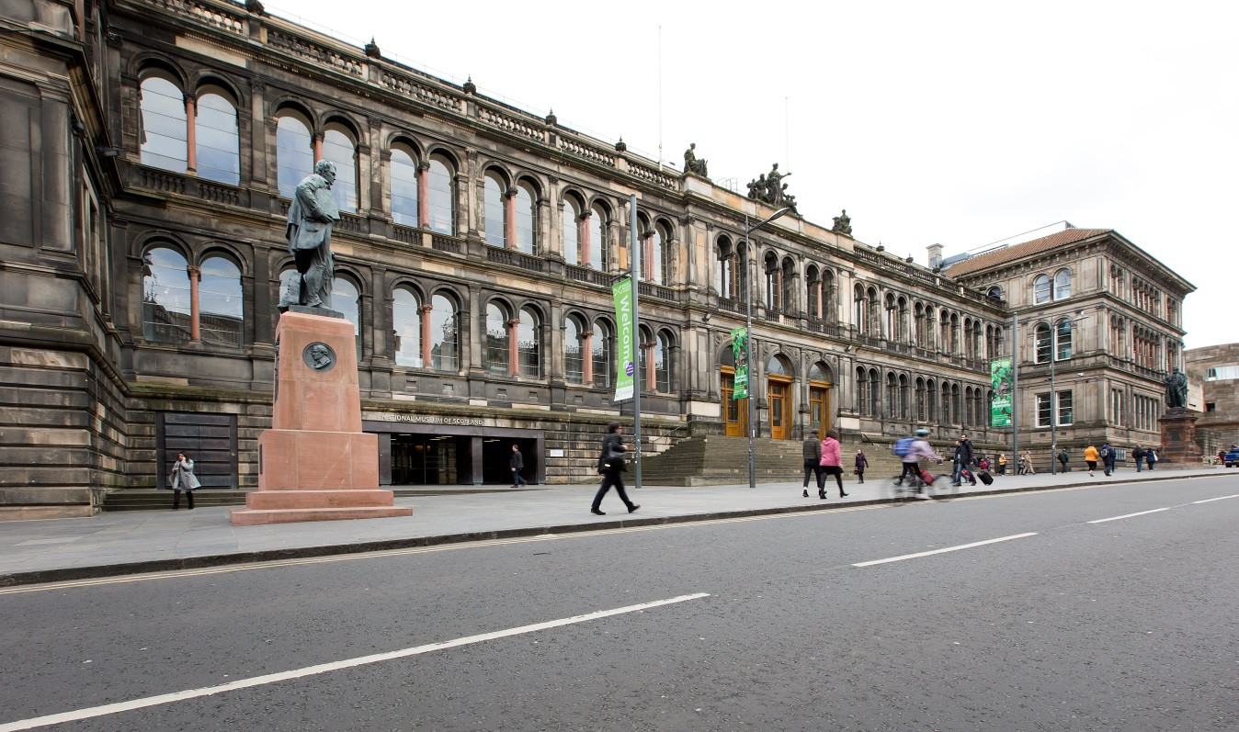
We are going to the National Museum of Scotland.

Slide 2
We are visiting the National Museum of Scotland on
We will be leaving school at

Slide 3
Museum Entrance
We will go into the museum through this entrance.
The sliding doors with the push button are easier for big groups to come in.

Slide 4
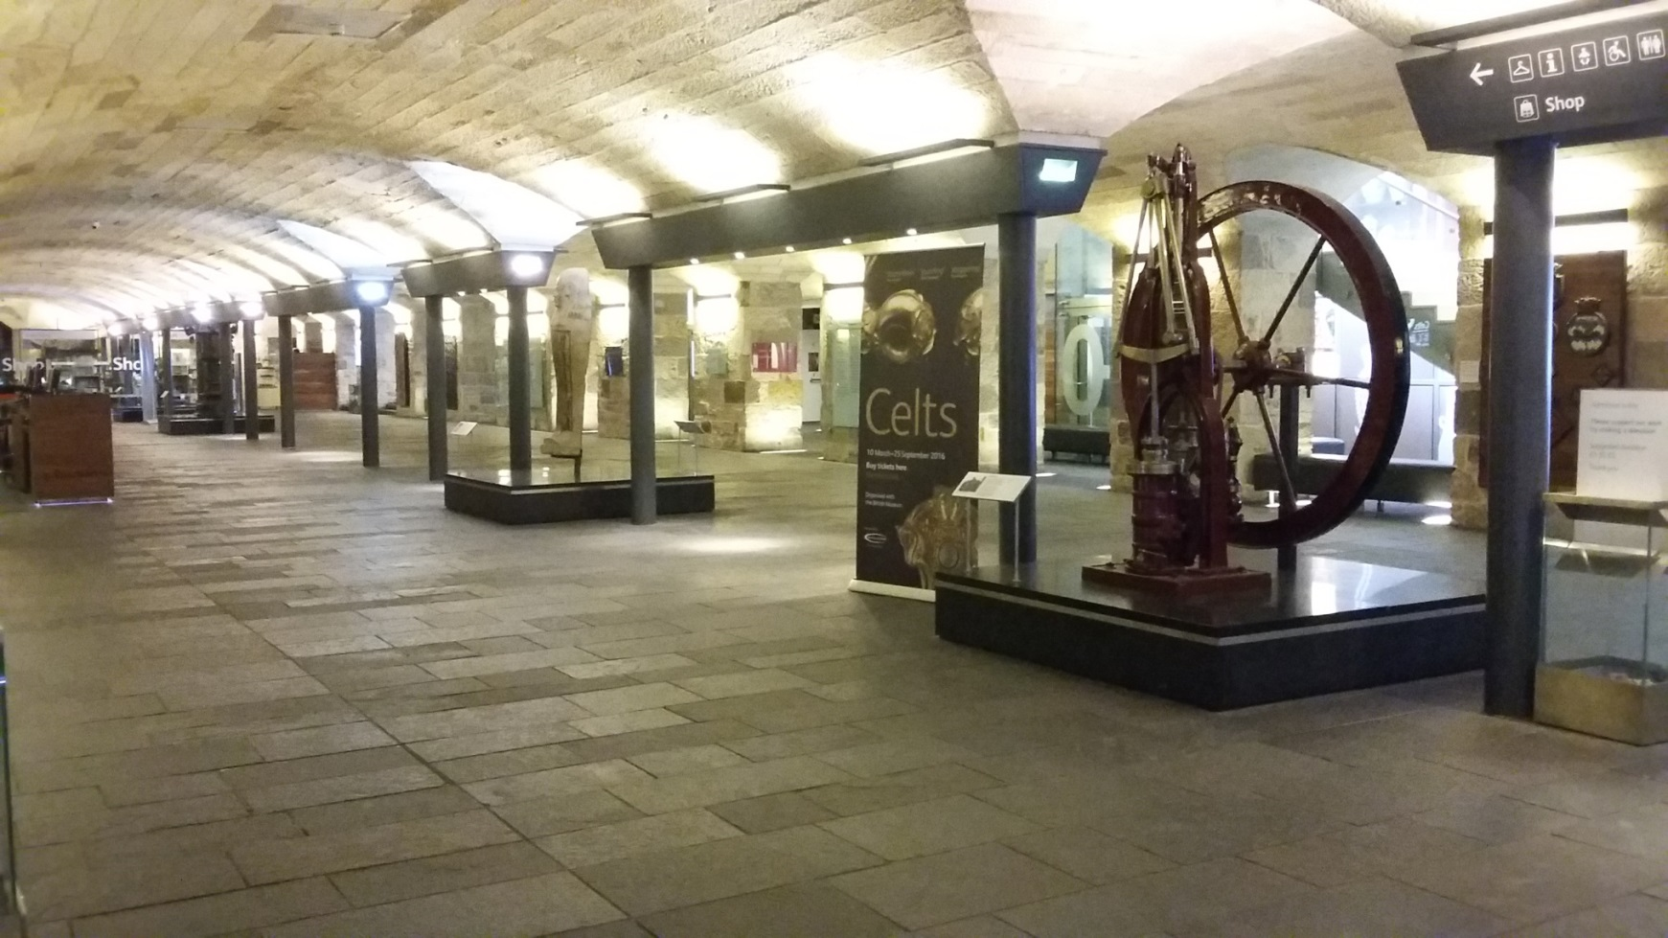
This is the Entrance Hall.
It might be noisy and busy so we will use our indoor voices.

Slide 5
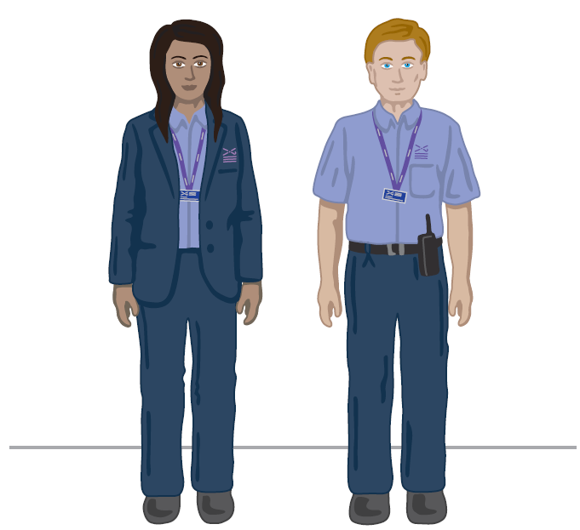
A Visitor Experience Assistant will show us where to leave our jackets and bags. They wear uniforms that look like this:

Slide 6
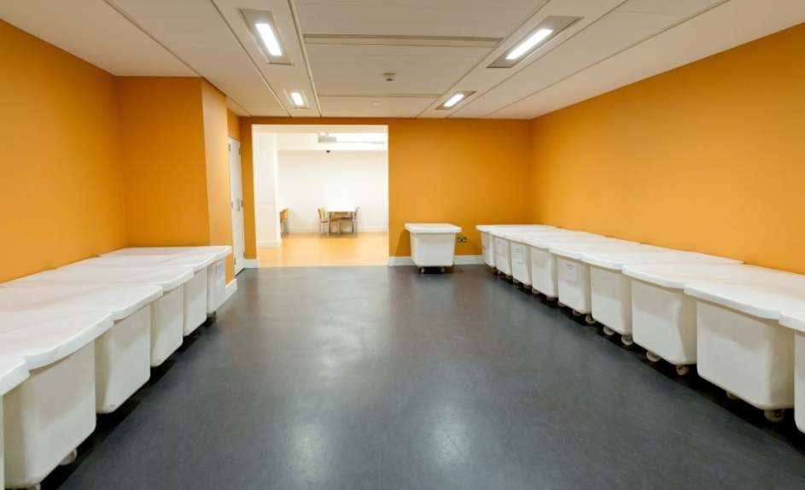
We will go into the Museum’s group space.
We will leave our bags and coats in the white tubs while we explore.
The white tub will have our school’s name on it.

Slide 7
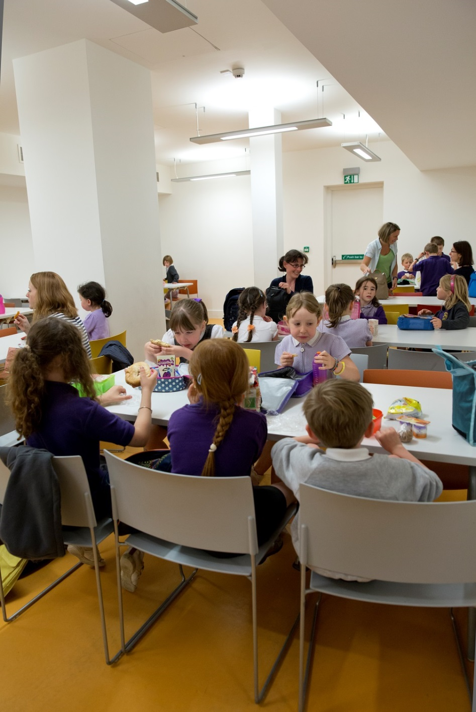
We can eat our snack and packed lunch here.
We might have to share tables with other schools.
We will need to tidy up after ourselves.

Slide 8
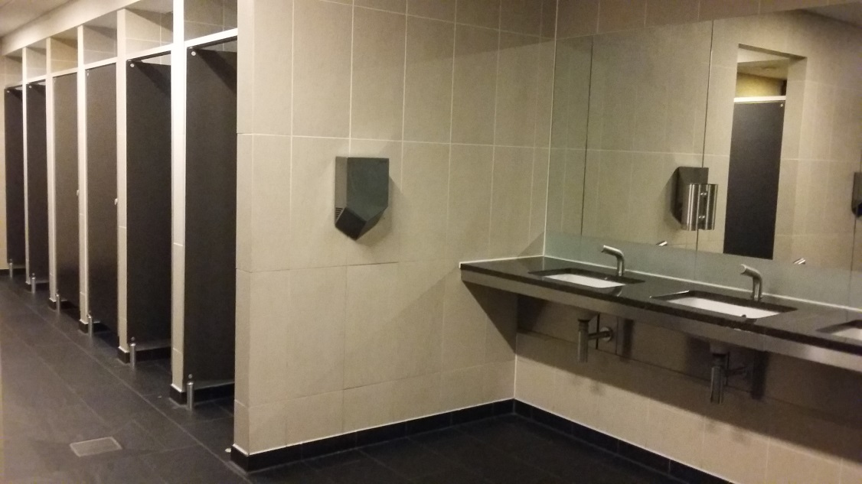
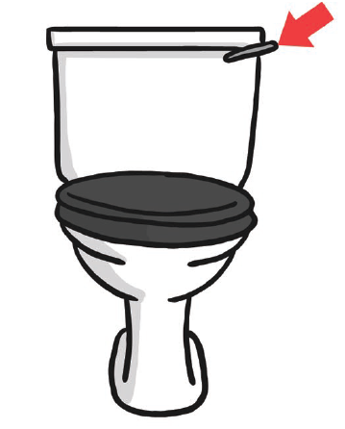
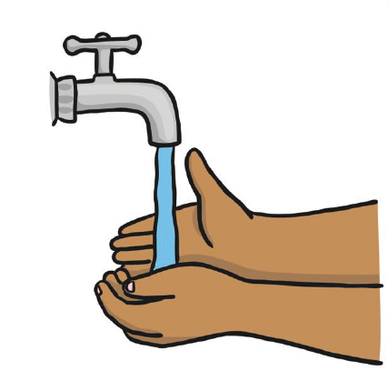
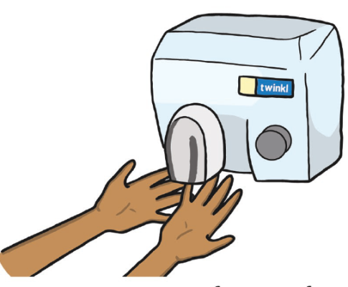
These are the toilets near the lunch space.
The hand dryers are very loud.

Slide 9
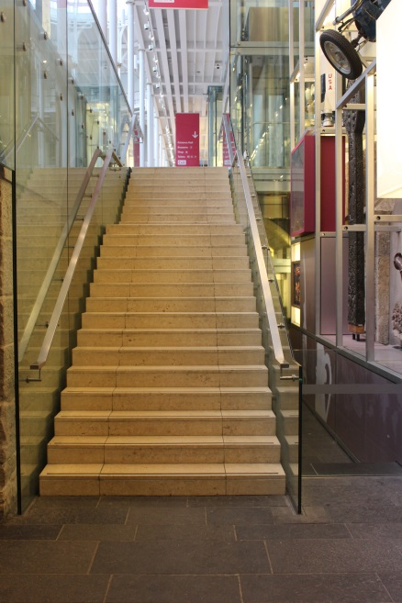
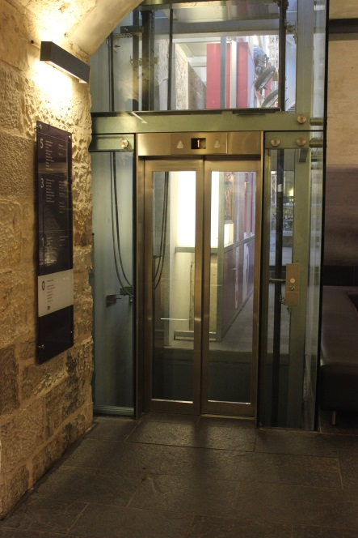
From the Entrance Hall we will go upstairs to get to the Grand Gallery. We can also take the lift.
Stairs
Lift

Slide 10
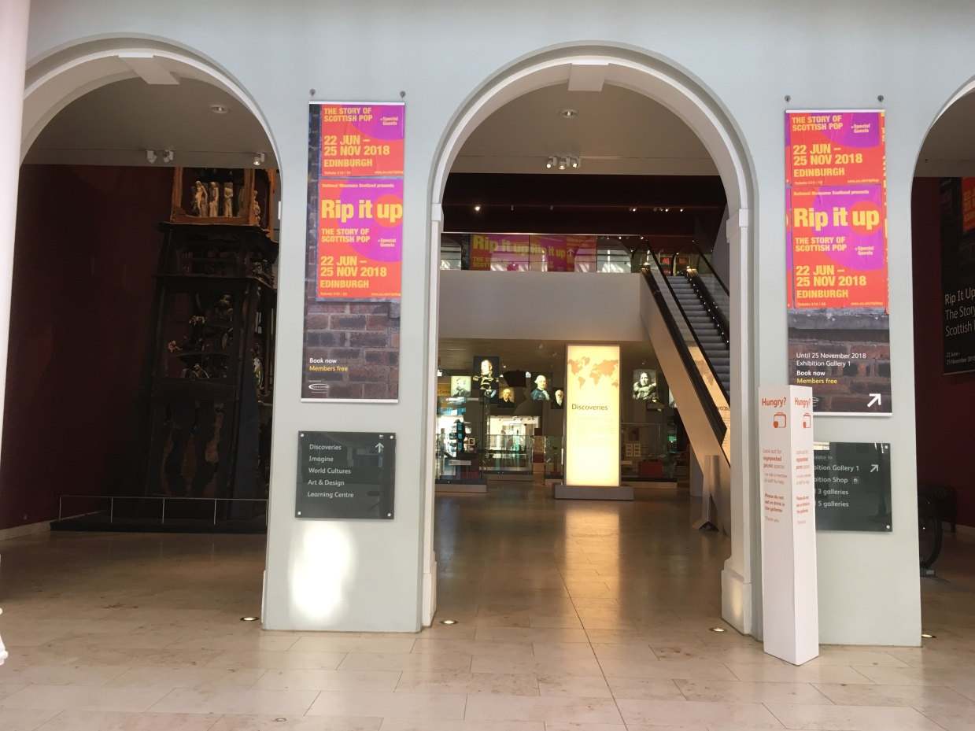
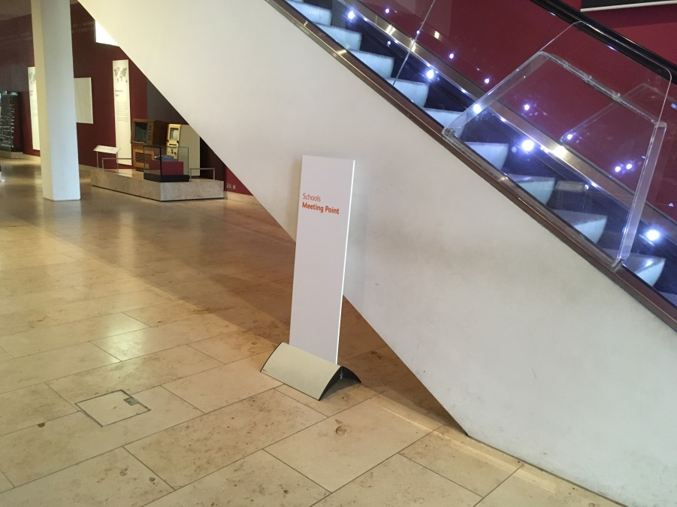
If we have an activity or workshop booked, we will meet at the Schools Meeting Point in the Grand Gallery. This is next to the Millennium Clock and escalator.

Slide 11
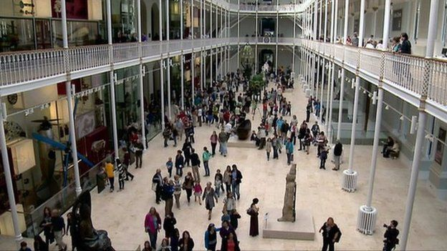
From the Grand Gallery, we will move around the museum in groups. We will stay with an adult at all times.

Slide 12
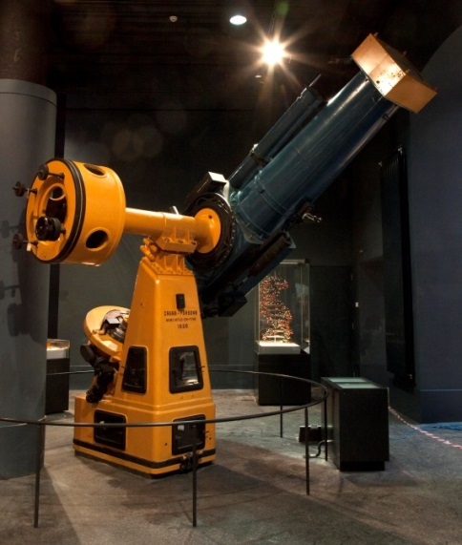
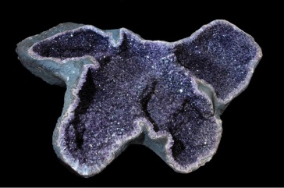
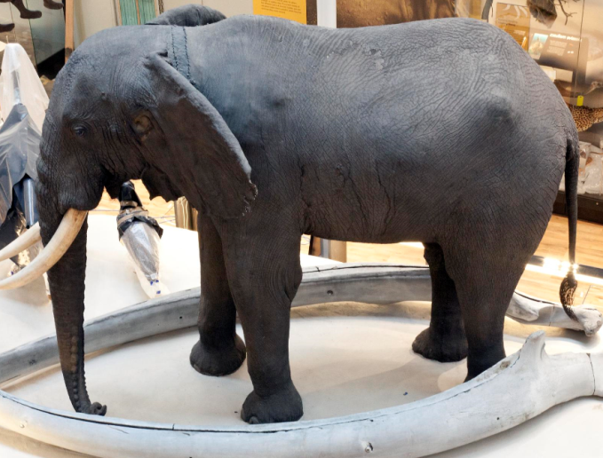
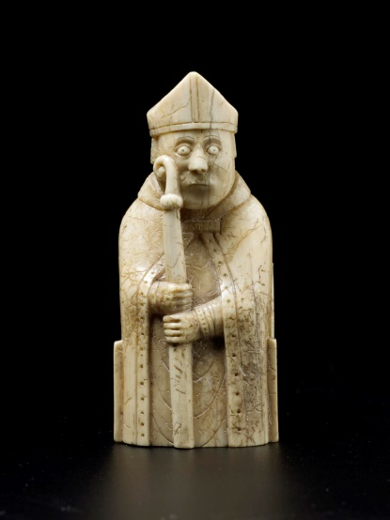
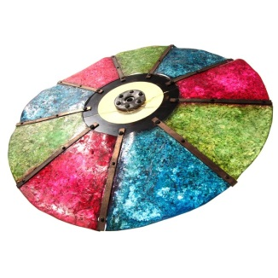
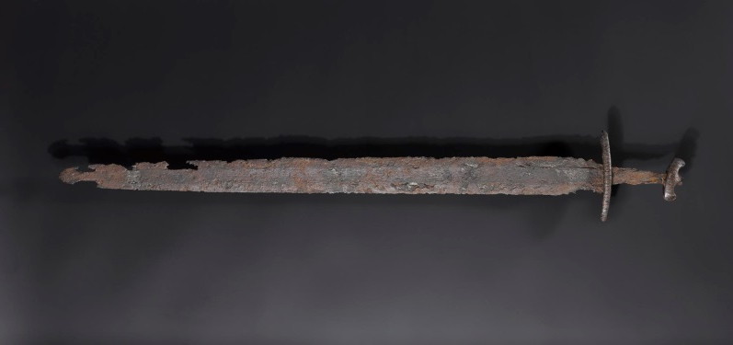
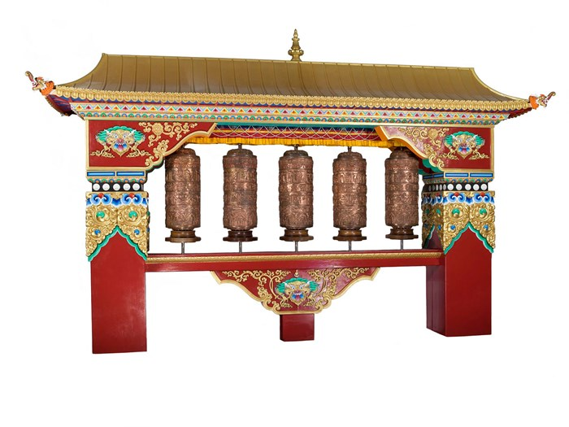
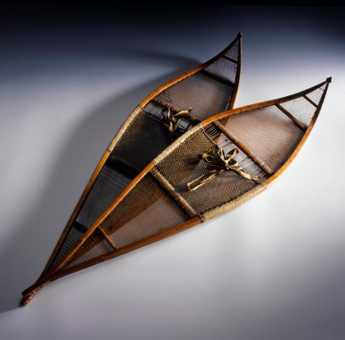
There is lots to see at the museum. We can plan what to see using a museum map or use a trail to find out more about a topic.

Slide 13
Our topic is
Add in what you are planning on looking at e.g.
Animals
Space
Vikings etc.
If you want to add in pictures of some of the museums’ objects you can search the collections here: http://www.nms.ac.uk/explore/search-our-collections/
This could be a fun pre-visit planning activity.

Slide 14
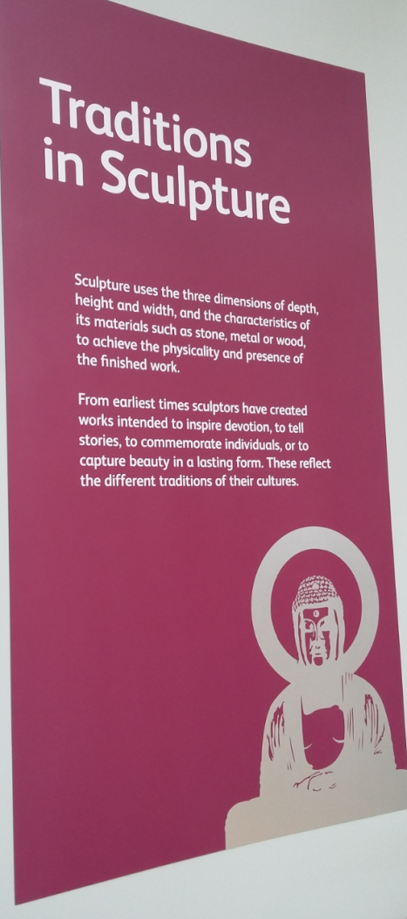
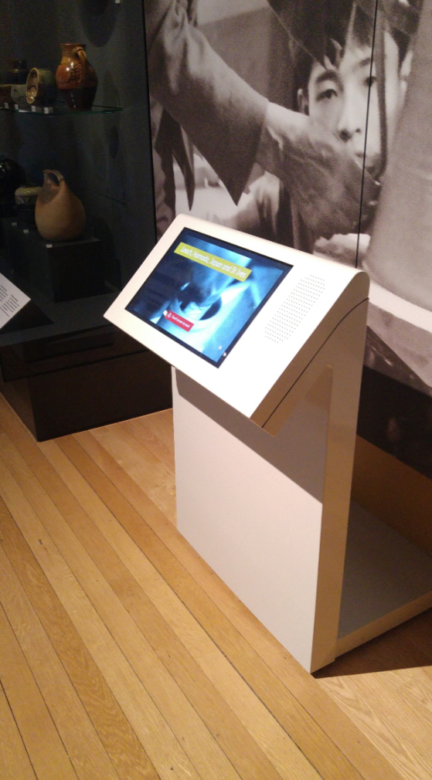
We can find out more about our topic.
Panels on the wall and labels in the cases will tell us about what we can see.
There might be touchscreen computers where we can find out more.

Slide 15
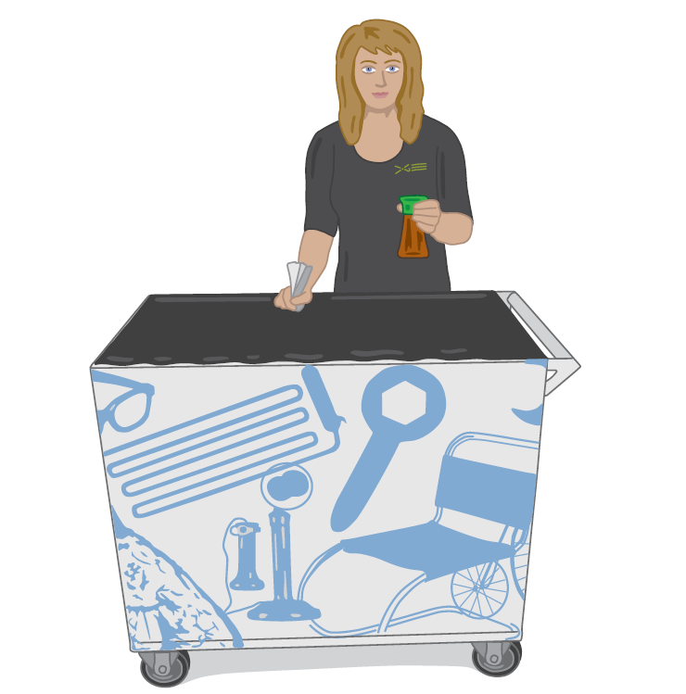
In Explore, Adventure Planet or Imagine, we might meet an Enabler. Enablers can help us learn and explore. We can ask them to try experiments, play games, or handle objects.

Slide 16
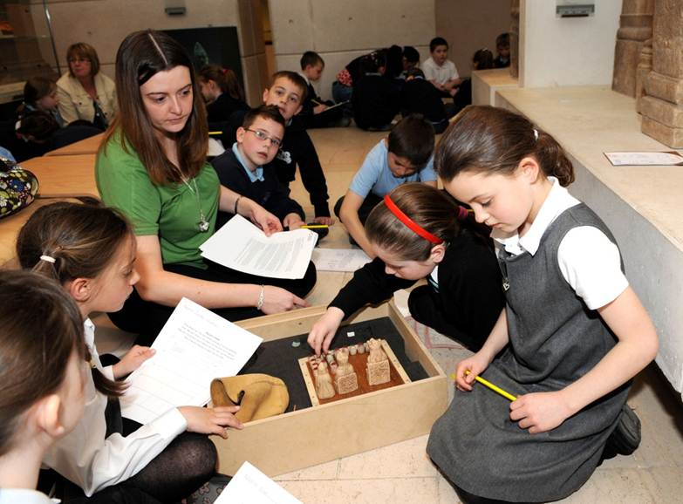
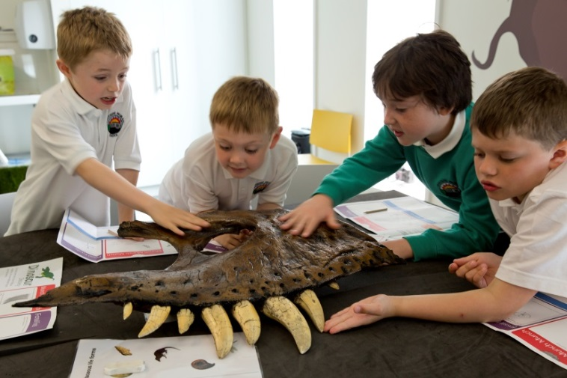
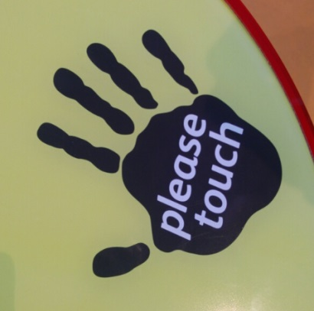
We might touch some objects.
If we can see the ‘please touch’ sign on an object then we can touch it. If not, don’t touch the object.

Slide 17
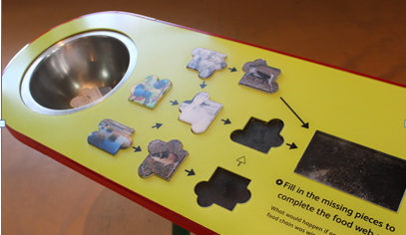
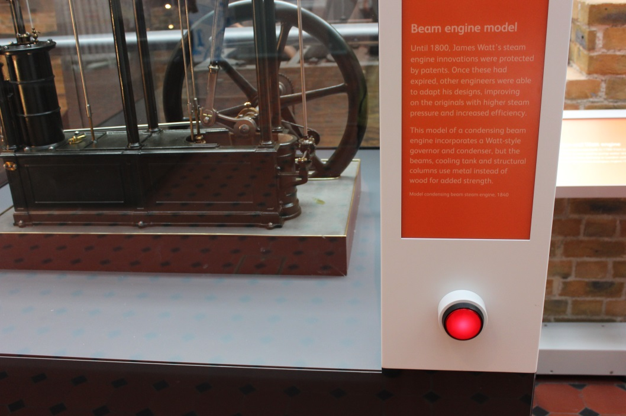
In some galleries, there are games to play and buttons to press.

Slide 18
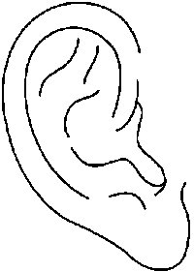
We might hear…
Other people talking, shouting and laughing
Music from the Millennium clock or from musical instruments
Beeps, whirring and clanking from some of the machines

Slide 19
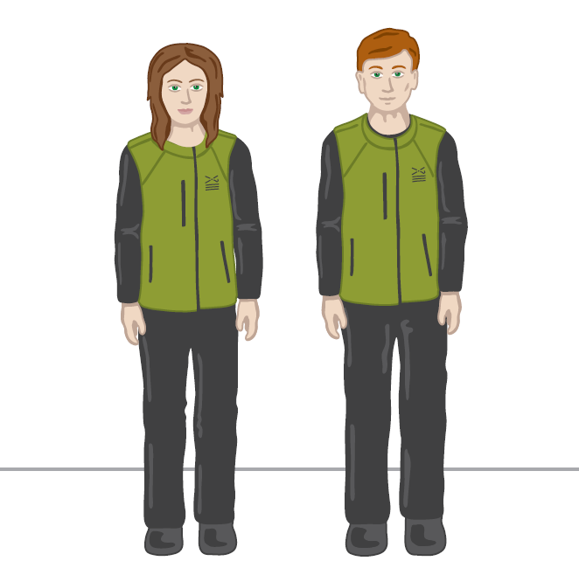
If we need help or want to ask a question, we can talk to someone who works at the museum.
They wear uniforms that look like this:
Visitor Experience Assistant
Enabler

Slide 20
When it’s time to leave, we’ll collect our belongings.

Slide 21
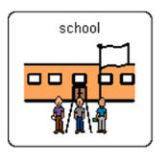
We will leave the museum at
We will go back to school.

