Slide 1
Teachers This guide is for a 12.30pm workshop. You can edit and adapt to use with your class.

Slide 2
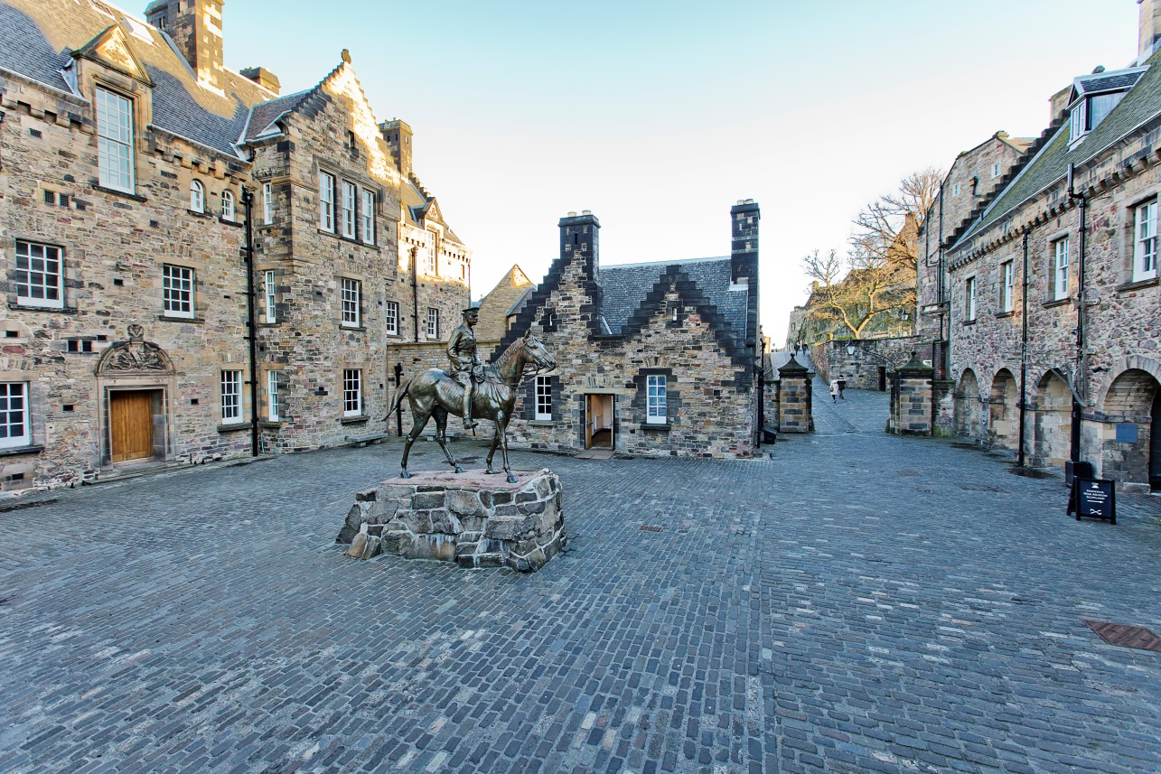
We are going to the National War Museum
Notes:
©Ruth Armstrong Photography

Slide 3
The National War Museum is in Edinburgh Castle.

Slide 4
We are visiting the National War Museum on
We will be leaving school at

Slide 5
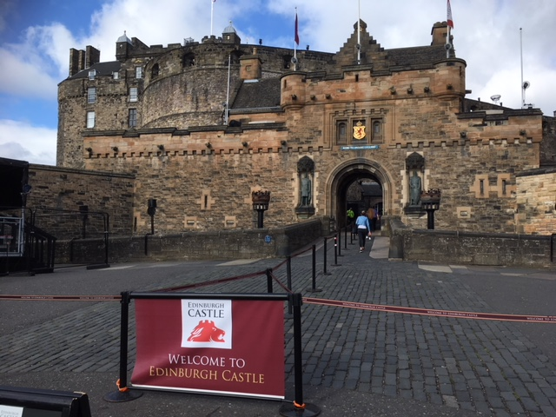
Castle Entrance
We will arrive at Edinburgh Castle. An adult will have to go over the drawbridge to collect our tickets while we wait on the Castle Esplanade.

Slide 6
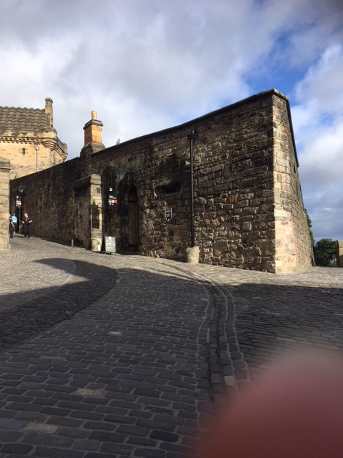
Ticket Collection
Our tickets will be collected from this building. The adult will then return to the Castle Esplanade to give us our own individual ticket.

Slide 7
Castle Entrance
Once we have our own ticket we will be able to enter Edinburgh Castle.

Slide 8
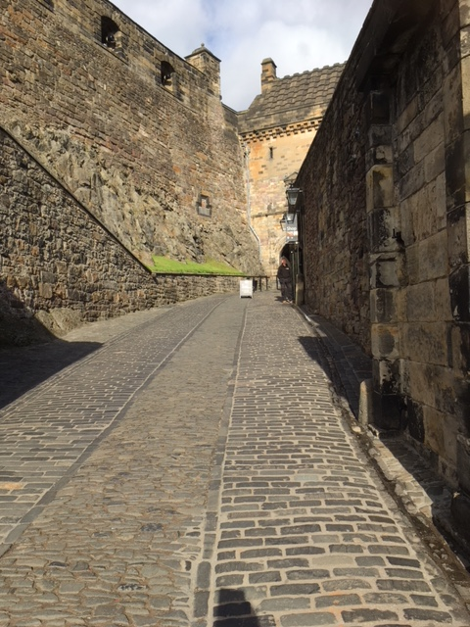
Ticket Collection
We will need to show our tickets to the member of staff waiting here.

Slide 9
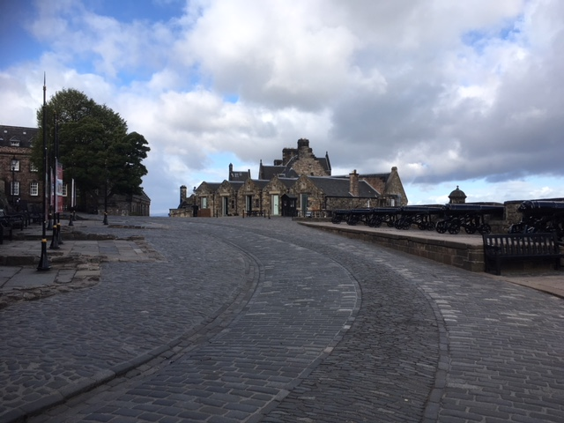
Travelling to the National War Museum
Once we have shown staff our tickets we will need to make our way along this path to the National War Museum.

Slide 10
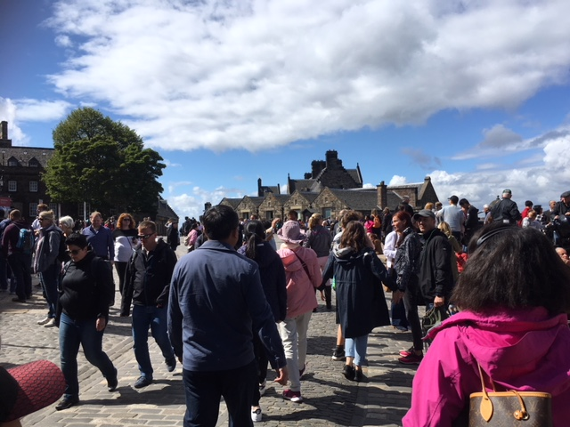
Travelling to the National War Museum
Sometimes it can be very busy so we need to make sure we stay with our adults.

Slide 11
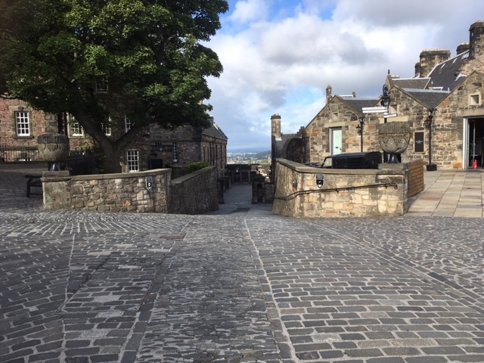
Travelling to the National War Museum
Follow the path down the hill. Please be careful as there might be some moving vehicles.

Slide 12
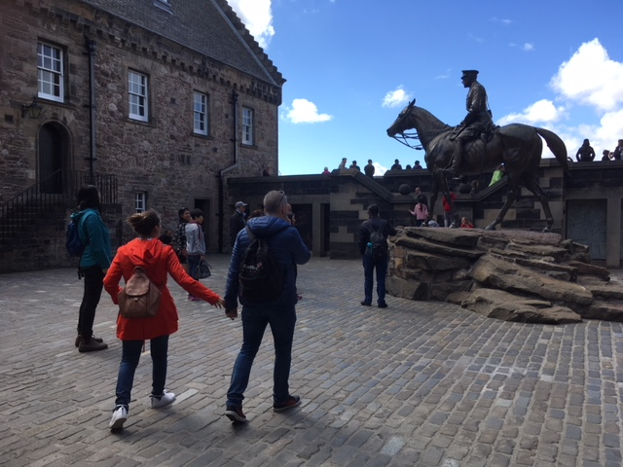
Travelling to the National War Museum
We will arrive at Hospital Square and see the statue of Earl Haig on his horse.

Slide 13
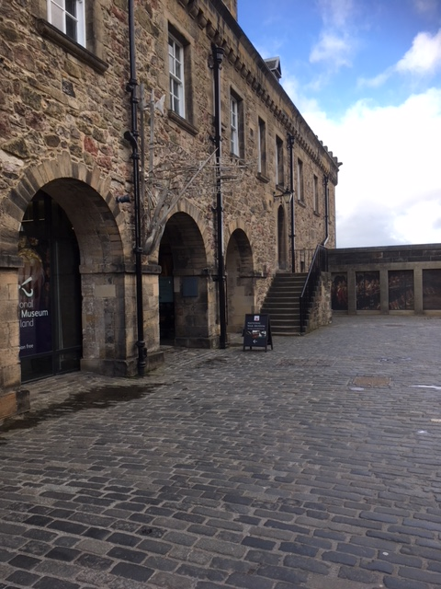
Museum Entrance
The National War Museum entrance is on the left. An adult will go in and introduce themselves to a member of the museum staff.

Slide 14
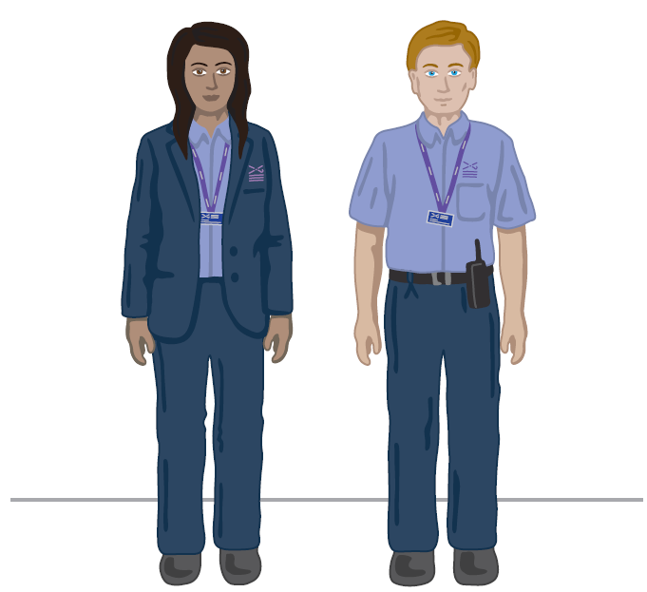
We will meet a Visitor Experience Assistant who can answer our questions or help if we need it. They wear uniforms that look like this.
Visitor Experience Assistant

Slide 15
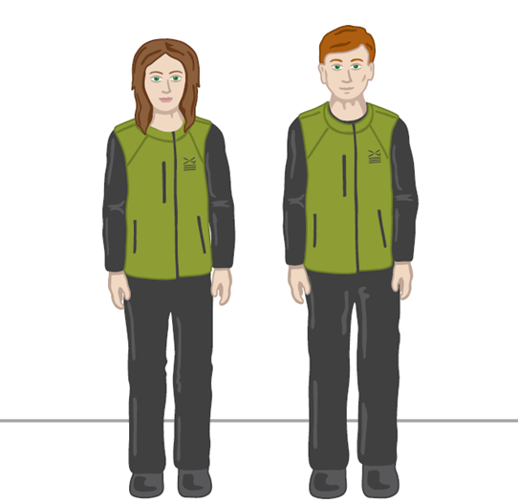
Enablers wear this uniform. They will meet us at the museum entrance and introduce our session starting at 12.30.
Enabler

Slide 16
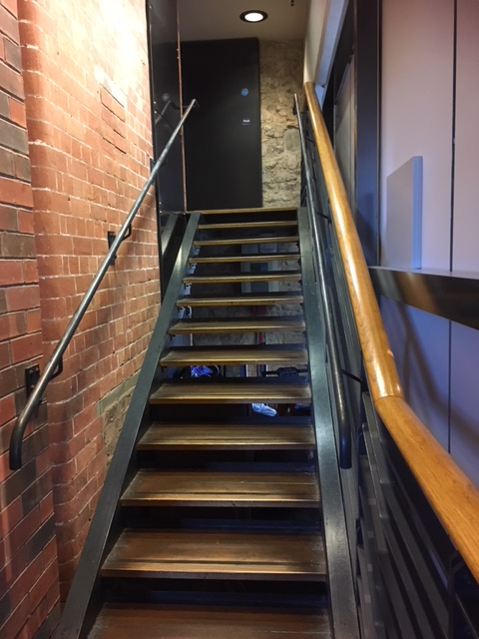
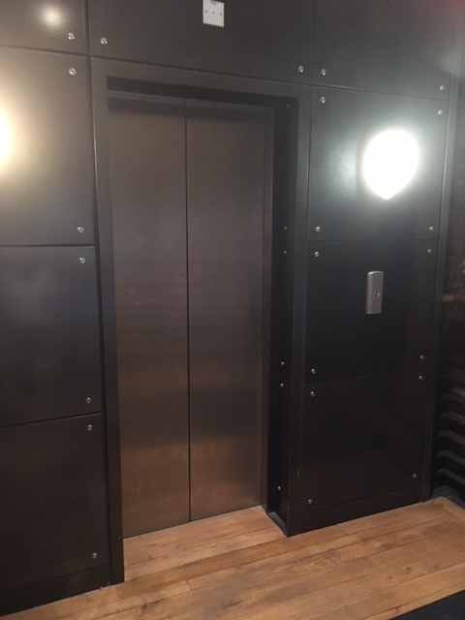
When travelling around the National War Museum we might need to use the stairs or lift.
Stairs Lift

Slide 17
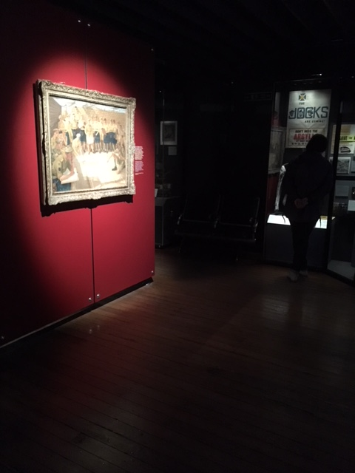
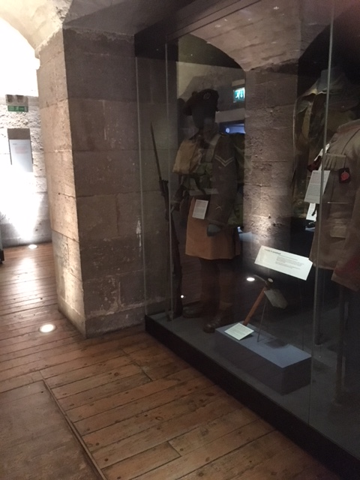
Some people might find parts of the museum quite dark.

Slide 18
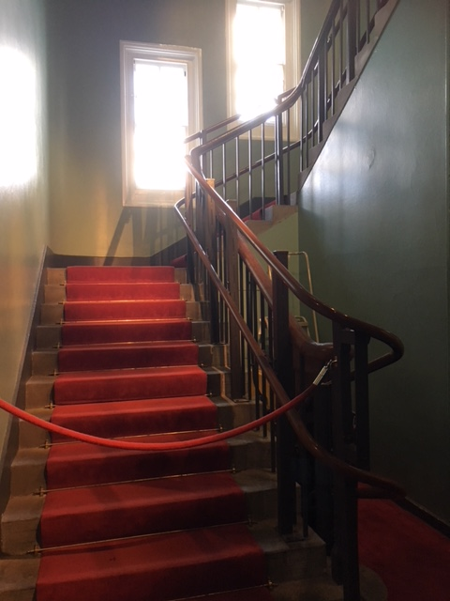
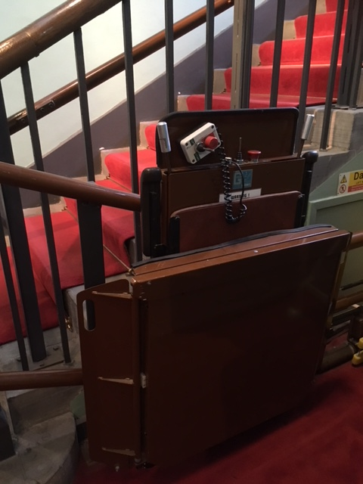
We will be using these stairs or chairlift to get to our workshop.

Slide 19
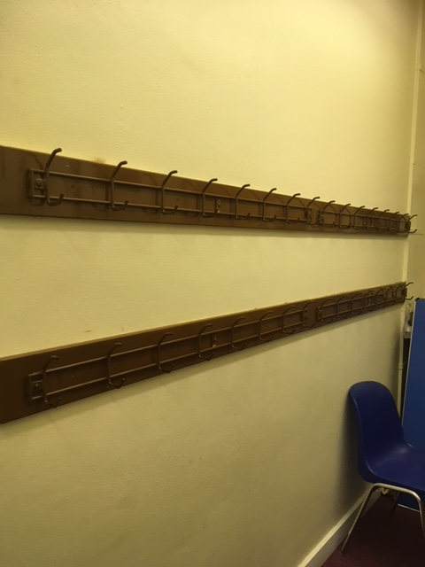
Once we reach the top of the stairs we will leave our coats and bags here.

Slide 20
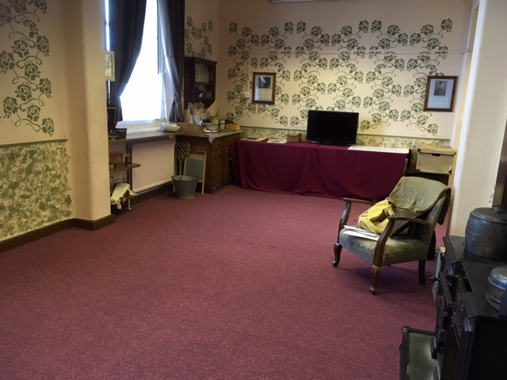
We will then be able to enter the Wartime Life Room and start our workshop.

Slide 21
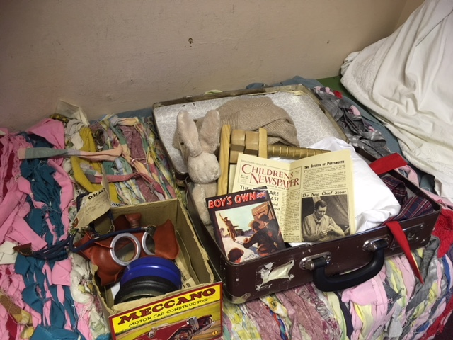
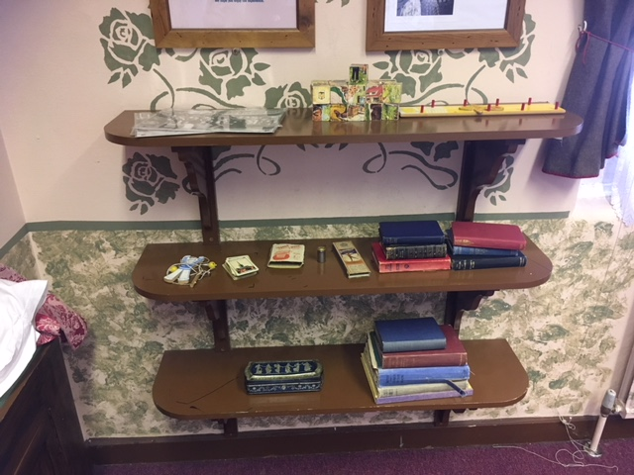
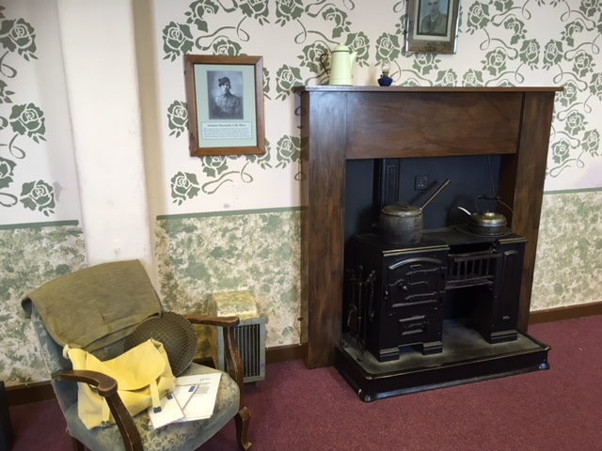
We will see lots of different objects in the room.

Slide 22
When it’s time to leave, we will collect our belongings and make our way back down the stairs.

Slide 23
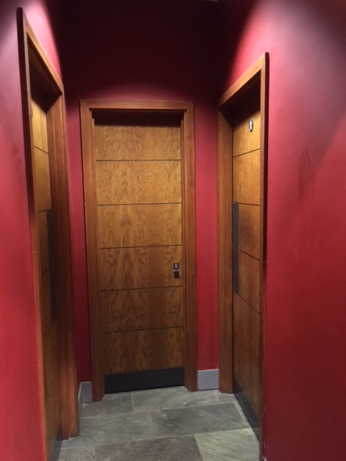
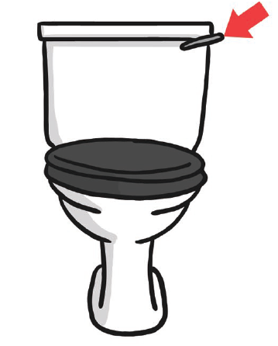
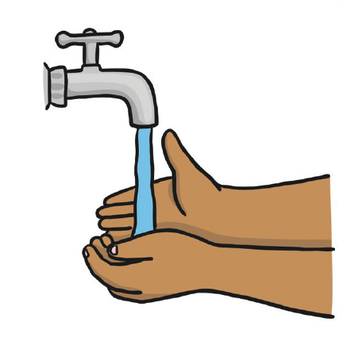
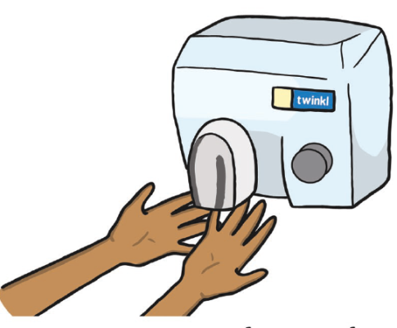
These are the toilets at the Museum.
The hand dryers are very loud.

Slide 24
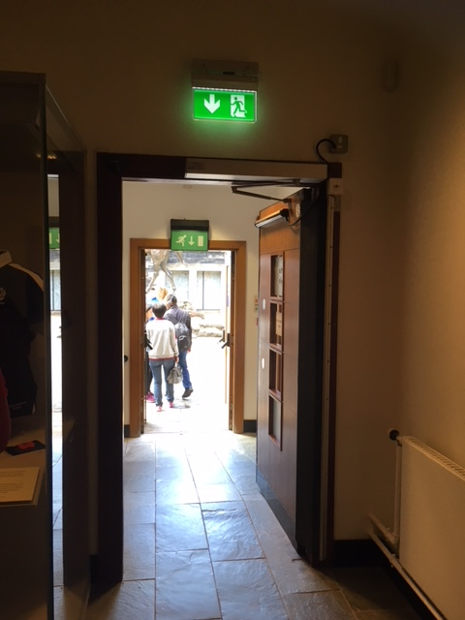
We will exit the War Museum through this door.

Slide 25
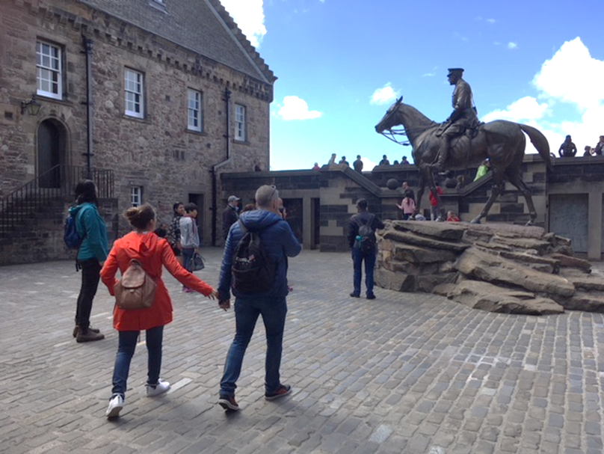
We will be back at Hospital Square ready to leave the National War Museum.

Slide 26
We can eat our lunch outside and borrow a picnic blanket to sit on. The corner of Hospital Square is a sheltered spot.

Slide 27
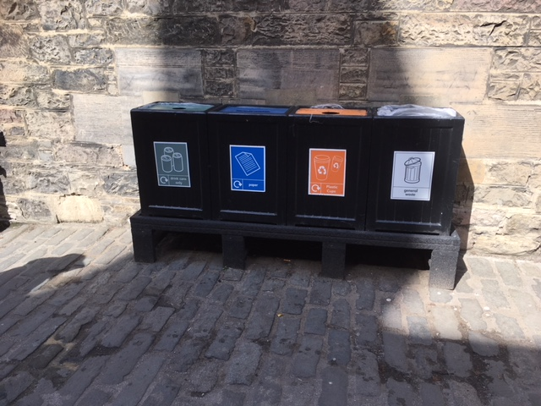
If we have any litter or recycling we can put it in the bins provided.

Slide 28
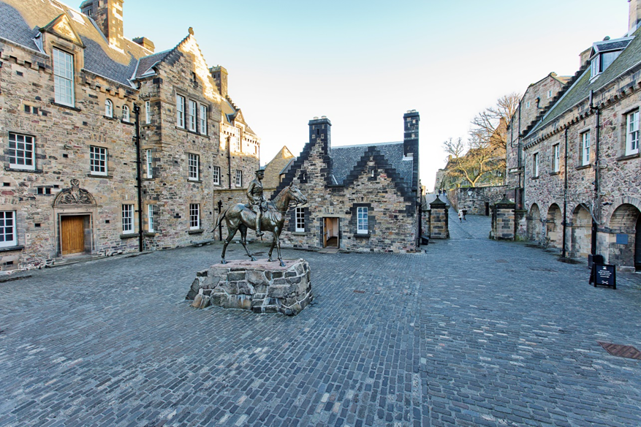
We can plan our visit by using the museum website. We can explore the rest of the Castle during our day out.

Slide 29
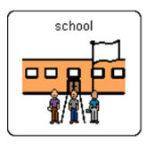
We will leave the Castle at
We will go back to school.

Slide 30
Our topic is
Add in what you are planning on looking at e.g.
WW1
WW2
If you want to add in pictures of some of the museums’ objects you can search the collections here: http://www.nms.ac.uk/explore/search-our-collections/
This could be a fun pre-visit planning activity.

